Slide 1

FOR THE CODER · WALKED THROUGH SLIDE BY SLIDE
Notes:
This deck is written for a technical peer. Open with the thesis, then walk the architecture, pipeline, portfolio, and per-app deep dives. Total ~30 slides.

Slide 2
THE THESIS
One person + AI copilot + a Meshy 3D pipeline
equals a small studio.
Twenty apps live · one shared asset library · Cloudflare Pages + Netlify + Cloudflare Workers · Supabase for the commercial rail-planning tools.

Slide 3
WHAT'S INSIDE
Contents
01
Under the Hood
architecture, pipeline, shared code
02
The Portfolio
20 apps, one grid
03
App Deep Dives
Story House 3D · Magic Workshop · Iskra · Scribe · Build World · Rail
04
Reusable Pieces
shared 3D asset library, api-keys helper, deploy scripts
05
Performance
phone/tablet guardrails and how we verify
06
Roadmap
open problems worth collaborating on

Slide 4

Under the Hood
Architecture, pipeline, shared code

Slide 5
01 · UNDER THE HOOD
Architecture at a glance
CLIENT
single-file HTML per app (~400KB each) · vanilla JS · three.js r128 · localStorage/IndexedDB · no build step for most apps
PROXY
shared/api-keys-helper.js (Node) + per-app Cloudflare Pages Functions (functions/api/*) — API keys never leave the server
APIs
Meshy (3D generation) · Anthropic Claude (notes, translation) · Replicate Whisper (STT) · Higgsfield (renders) · Todoist (out)
STORAGE
Cloudflare KV (couple sync, own-device mirror) · Supabase (rail-planning) · localStorage/IndexedDB (Scribe)
EDGE
Cloudflare Pages · Cloudflare Workers · Netlify (lovepapadavid) — deploy via wrangler; TLS everywhere; one config repo

Slide 6
01 · UNDER THE HOOD
The Meshy 3D pipeline — drawing to dollhouse
1
2
3
4
5
Source art
Image → 3D t-pose
Remesh + rig
Animate
Ship to phone
Higgsfield 2K images (~2cr each) when image→3D beats text→3D. Or a photo of Arianna's drawing.
Meshy image-to-3D (~20cr). Preview mode first; keep the reroll buffer.
Remesh to 120k tris. Rig h=1.2m so scale matches Story House 3D's grid.
3 anims per character: wave/sit/dance (~10cr). Reused via shared library.
gltf-transform resize 512 + draco → ~0.3–1.5 MB GLB. Test on a real phone.
Fully animated character total: ~40–55 credits. 10k/month = ~200 characters or 300–400 props.

Slide 7
Credit economics — where the pipeline actually spends
40-55
25-35
~2
10k
cr per animated character
cr per textured prop
cr per source image
credits/month on Meshy MAX
image→3D + remesh + rig + 3 anims
text→3D preview + refine
Higgsfield when image→3D wins
≈ 200 characters or 300 props
Reversed the old "minimise Meshy spend" posture — the pool is meant to be spent.

Slide 8
01 · UNDER THE HOOD
Deploy stack — kept boring on purpose
CLOUDFLARE-FIRST
WHERE IT DIVERGES
Most kids' apps ship as Cloudflare Pages sites.
Edge Functions (functions/api/*) proxy the paid APIs so the client never sees keys.
Deploy is a one-liner per app:
cd app/ && npx wrangler pages deploy .
KV bindings hold couple-sync and own-device-mirror state (Iskra).
lovepapadavid hub is on Netlify — historical.
Workers (kitchen, suitcase, scribe) for anything that needs a token-gated cookie/API proxy at david-c73.workers.dev.
Supabase (project bokrkzyksnutlyzabpxp) is the spine of the commercial rail-planning tools — all commercial data has stayed inside Postgres.

Slide 9
01 · UNDER THE HOOD
The one file every app calls: shared/api-keys-helper.js
Single Node helper that abstracts every paid API.
Each app imports one function; environment variables handle secrets.
Same helper works locally and inside Cloudflare Pages Functions.
callMeshyCreate(payload) → wraps Meshy image-to-3D / text-to-3D
callMeshyTask(id) → polls Meshy job status
callClaudeNotes(transcript, model) → Scribe's summariser (Haiku/Sonnet/Opus)
callWhisper(audio_url) → Replicate Whisper (pinned version hash)
callHiggsfield(prompt, aspect_ratio) → marketing renders
callTodoist(items, token) → push action items out from Scribe

Slide 10

The Portfolio
Twenty apps sharing one warm studio

Slide 11

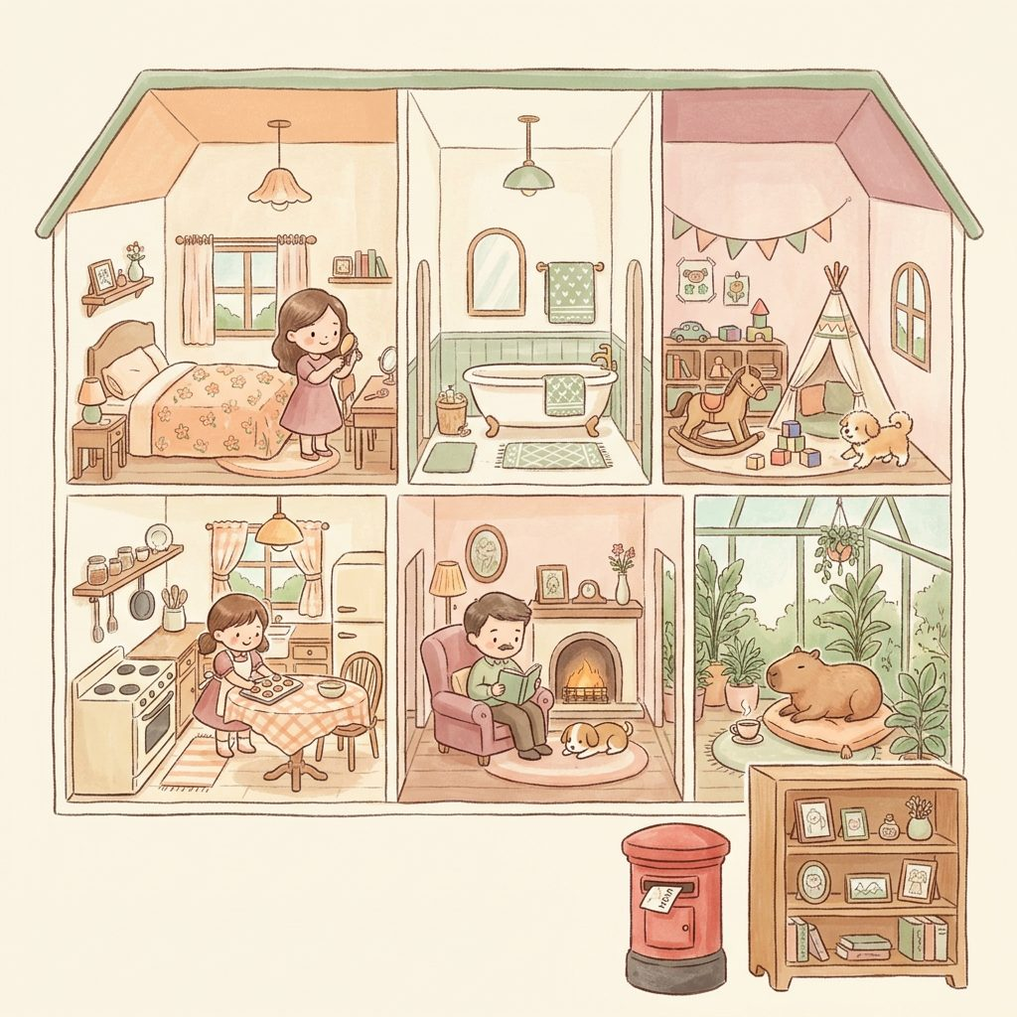













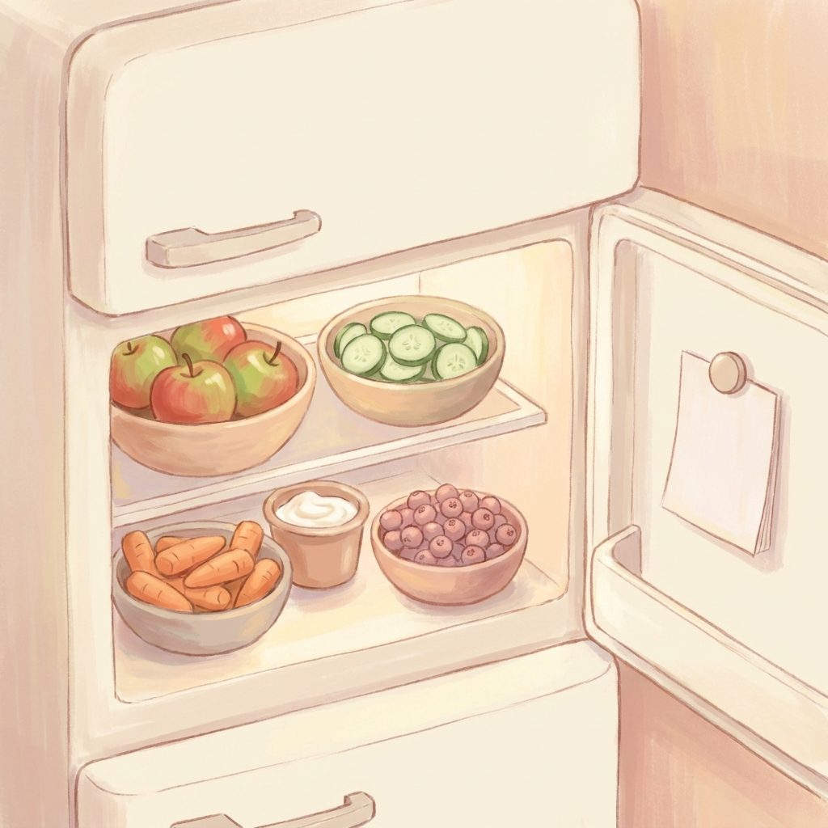



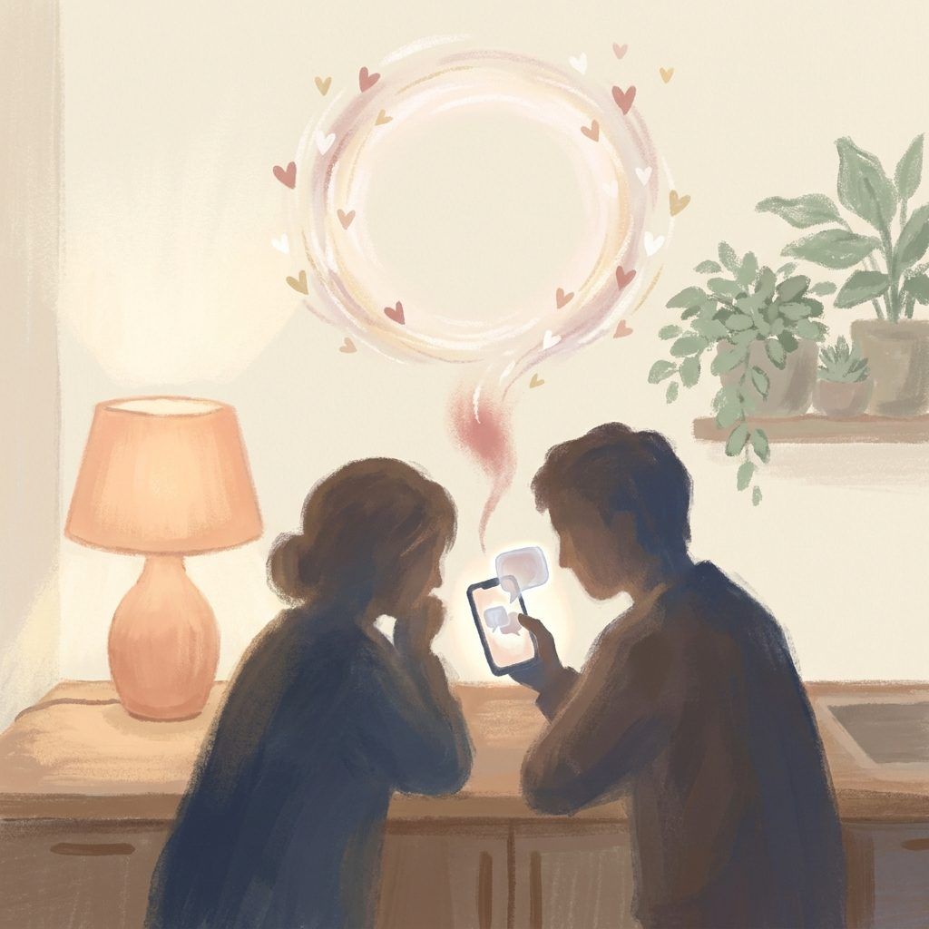
02 · THE PORTFOLIO
20 apps, one grid, one visual language
Story House 3D
Story House 2D
Sleeping Isles
Magic Shop
Café
Kapibara Book
Capybara Boom
Maths Quest
Travel Map
The Hollow
Garden of Words
Walkabout
Lantern Keeper
Firefly Reader
Arianna's Bookshelf
Arianna's Kitchen
Adventure Jar
Suitcase
BriTannia'State
Iskra · Искра
All live at Cloudflare Pages · Netlify · Cloudflare Workers

Slide 12
02 · THE PORTFOLIO
Every app · category · tech · live URL
App | Category | Tech | Lives at
Story House 3D | kids · flagship 3D | three.js r128 · Meshy pipeline | story-house-3d.pages.dev
Story House 2D | kids · 2D dollhouse | vanilla JS · postbox + Keepsake | story-house.pages.dev
Sleeping Isles | kids · point-and-click | vanilla JS · inventory + NPCs | :8788 (dev)
Magic Shop | kids · business sim | vanilla JS · ledger | :8766 (dev)
Café | kids · cooking | vanilla JS · nutrition rules | :8768 (dev)
Kapibara Book | kids · picture book | vanilla JS · dress-up + camera | :8780 (dev)
Capybara Boom | kids · card game | vanilla JS · card engine | :8791 (dev)
Maths Quest | kids · pedagogy maths | vanilla JS · 6 regions | :8771 (dev)
Travel Scratch Map | kids · geography | vanilla JS · SVG world | :8769 (dev)
The Hollow | kids · cozy | vanilla JS · listening game | :8782 (dev)
Garden of Words | kids · slow-play | vanilla JS · real-day cadence | :8781 (dev)
Iskra · Искра | couples · RU/EN | vanilla JS · KV sync · i18n | iskra.pages.dev
Papa's Magic Workshop | 3D · drawings→toys | three.js · Meshy image-to-3D | magic-workshop.pages.dev
Scribe | utility · voice | Cloudflare Worker · Whisper | scribe.david-c73.workers.dev
Arianna's Build World | 3D · build space | three.js r128 · touch orbit | prototype
railplanning.tools | commercial · rail ops | Supabase · Postgres · multi-app | railplanning.tools

Slide 13
App Deep Dives
The six that show the range

Slide 14
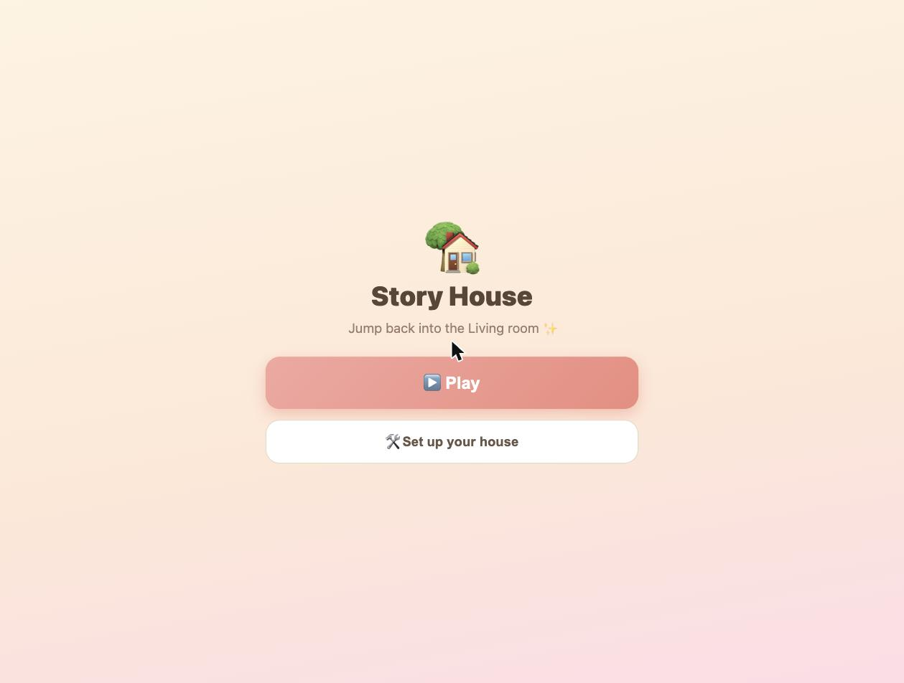
APP · DEEP DIVE
Story House 3D
A walkable painterly dollhouse for phones and tablets.
LIVE
LIVE at story-house-3d.pages.dev
code/walkabout-3d/index.html · single-file three.js app
STACK
three.js r128 · custom touch-orbit camera · GLB assets · draco compression · Cloudflare Pages
HARDEST PROBLEM SOLVED
NOVEL CHOICES
Making 38 friend-character GLBs load lazily without blowing the phone budget. Solved with a lazy Friends picker + a shared instanced prop library + gltf-transform draco.
Custom animated water + lapping foam waterline in fragment shader (verified across day/sunset/night). Party button that emotes all present characters at once. Single-file HTML app — no bundler.
hero render + live screenshot inset
LIVE

Slide 15
STORY HOUSE 3D · ASSETS
The shared 3D asset library — the reason the pipeline pays off
One capybara, one tree set, one food set, one furniture set — reused across Story House 3D, Café, Magic Shop, Kapibara, Sleeping Isles.
Ship more games for less. The library is the moat.
Characters
38 friends · papa · Arianna · capybara · dog · emotes: wave (28f), sit (32f), dance (596f)
Props
hero-palm · hero-gardentree · hero-rocks · hero-hedge · food · furniture · vehicles
Places
bedroom · kitchen · living room · garden · beach · park (day/sunset/night)
Wardrobe
dress-up v1 outfits (parent-paid packs candidate)

Slide 16

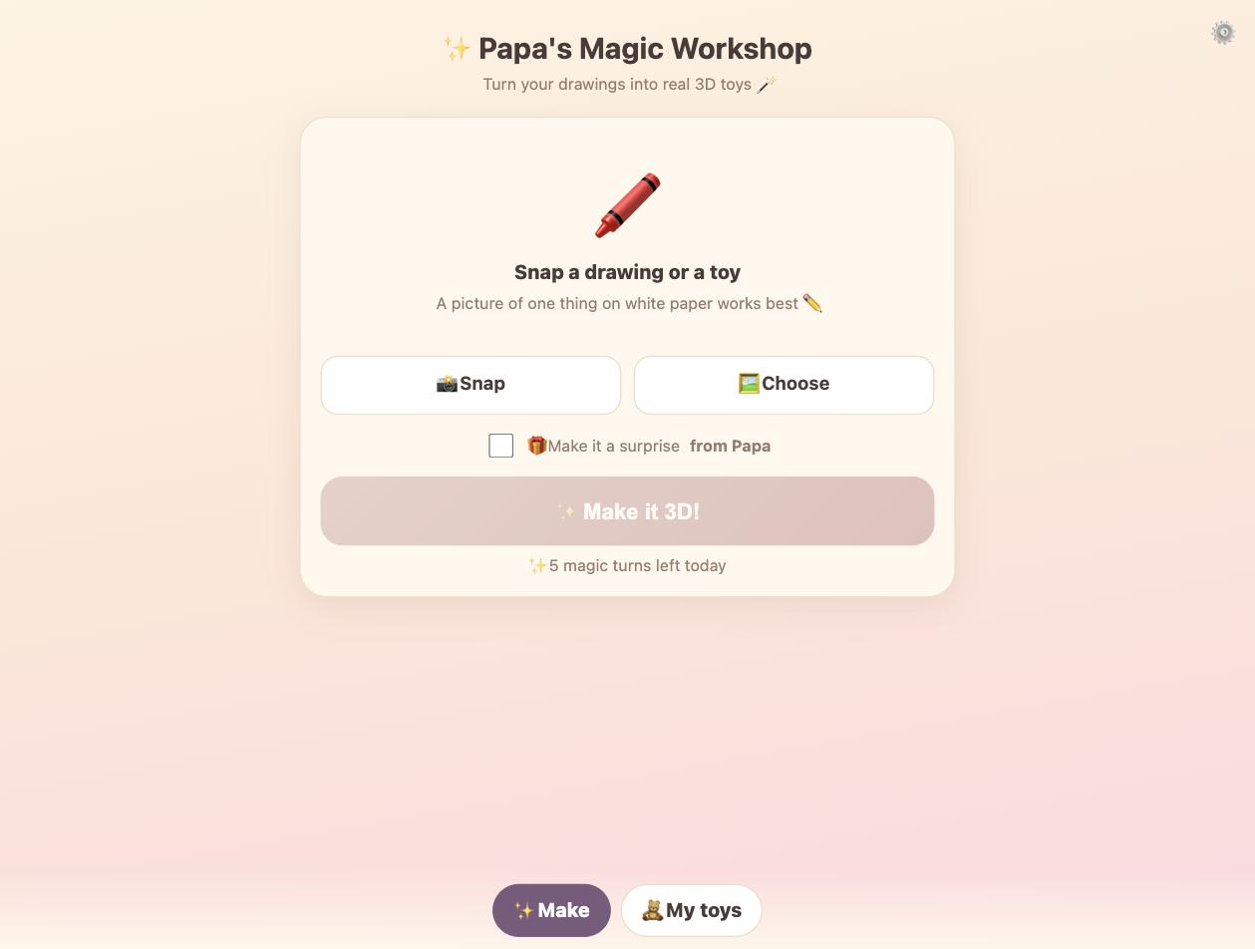
APP · DEEP DIVE
Papa's Magic Workshop
A drawing → 3D toy magician for phones. Print-ready STL/OBJ included.
LIVE
LIVE at magic-workshop.pages.dev
Nova Code/magic-workshop/ · functions/api/meshy-*
STACK
single-file HTML · three.js viewer · Meshy image-to-3D via Cloudflare Pages Functions · toy-box IndexedDB gallery
HARDEST PROBLEM SOLVED
NOVEL CHOICES
Hybrid child-safety flow: Arianna generates instantly with a daily magic-turn cap, PLUS a 'surprise from Papa' toggle. Parent-gated settings behind a kid-resistant math gate.
Two paths to production: local Node server calling shared/api-keys-helper.js; live Cloudflare uses functions/api/meshy-image-to-3d + meshy-task. Same client either way. Print-ready STL/OBJ export ties into the father-daughter 3D-printing thread.
hero render + live screenshot inset
LIVE

Slide 17
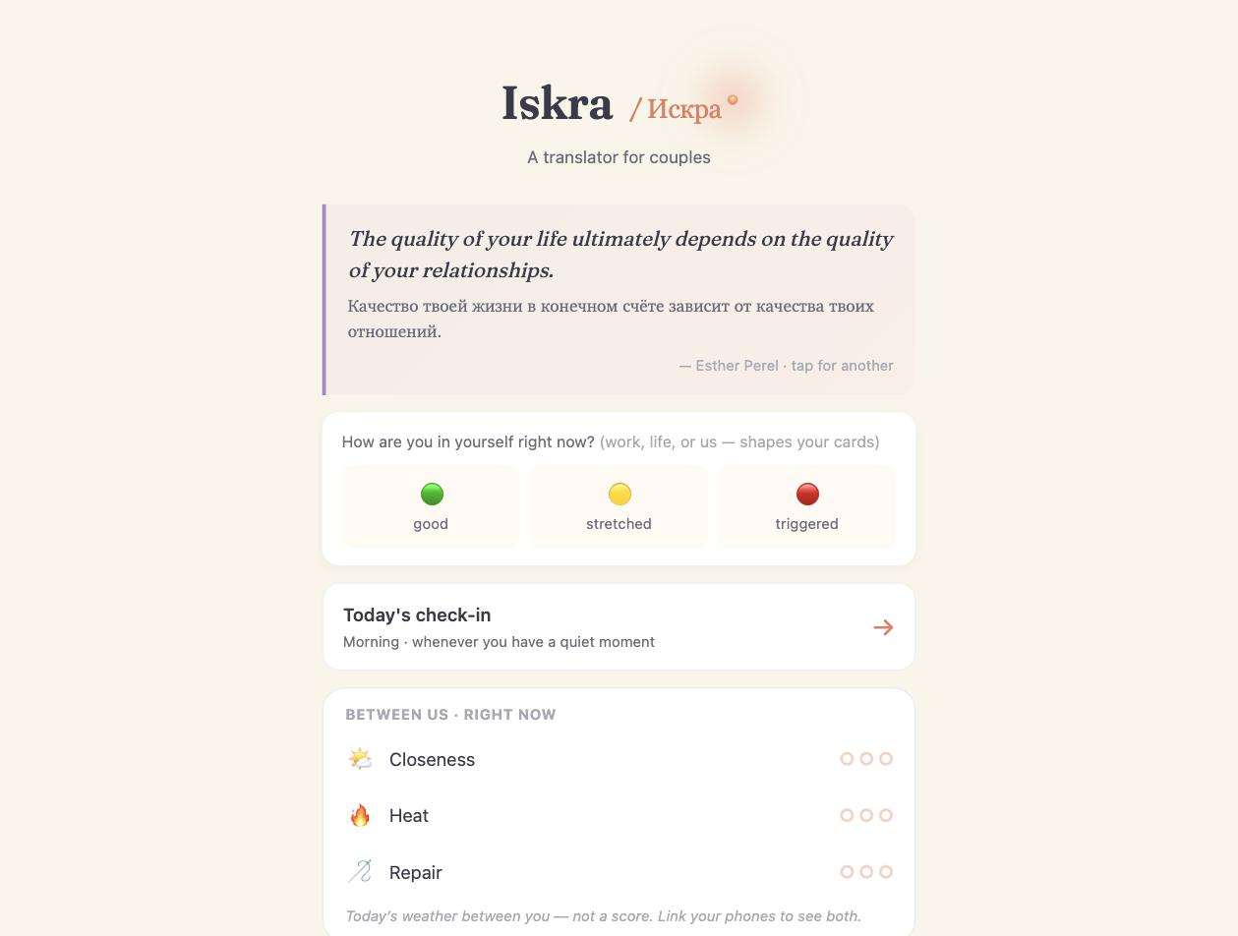
APP · DEEP DIVE
Iskra · Искра
Bilingual RU/EN couples app — translator, cards, together mode.
LIVE
LIVE at iskra.pages.dev
single-file HTML ~400KB · STR parity 560/560
STACK
vanilla JS · localStorage 'spark.v1' · Cloudflare Pages Functions · KV binding ISKRA_KV · en/ru STR parity 560/560
HARDEST PROBLEM SOLVED
NOVEL CHOICES
Three sync channels, all client-encrypted: couple link (per-slot outbox in KV), own-device mirror ('Self' full-store newest-wins by _selfRev), and two-device live engine (host deals, guest follows, liveReconcile locks both phones to one card).
Cycle/rhythms feature stays opt-in and sensitive: AI is never allowed to attribute the cycle. Brand-spark state dot: the green/amber/red 'how are you' collapses into a pulsing Iskra dot; tap to reopen. Names via getName('partner') — never hardcoded.
hero render + live screenshot inset
LIVE

Slide 18

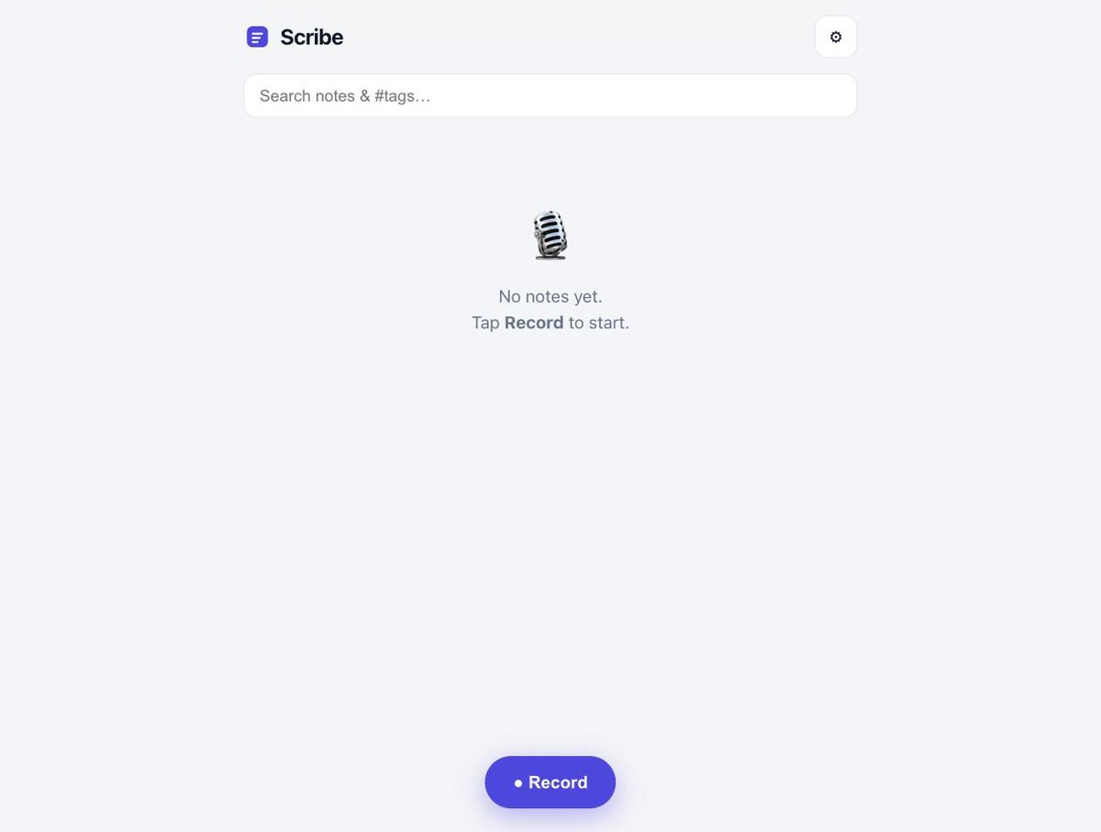
APP · DEEP DIVE
Scribe
Otter-style voice capture for rail work, events, and personal memos.
LIVE
LIVE at scribe.david-c73.workers.dev
Cloudflare Worker · token-gated ?k= · 1-year cookie
STACK
Cloudflare Worker (Nest template) · Anthropic Claude proxy · Replicate Whisper (pinned hash) · localStorage/IndexedDB · Todoist push
HARDEST PROBLEM SOLVED
NOVEL CHOICES
Whisper via Replicate: had to pin an incredibly-fast-whisper version hash — the model-path endpoint 404s for community models. Hidden model-picker (Haiku→Sonnet→Opus) means notes can be cheap or thorough.
Local-first by design: audio + captures live in IndexedDB on the device; only the transcription API round-trips. Noted-style timestamped markers; tap a [mm:ss] to seek. Action-items export → Todoist. Cookie keeps you in for a year after one ?k= visit.
hero render + live screenshot inset
LIVE

Slide 19
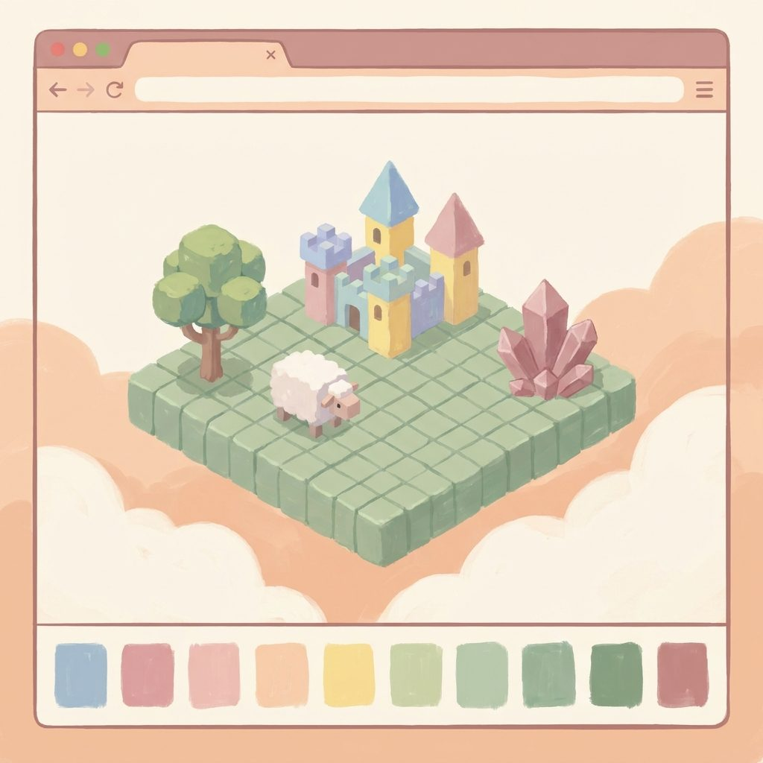
APP · DEEP DIVE
Arianna's Build World
A 3D browser build space — a soft Minecraft made by her papa.
PROTOTYPE
ariannas-build-world.html · self-contained single file
STACK
three.js r128 · custom touch-friendly orbit camera (no OrbitControls) · WebAudio synth SFX · 16×16 integer grid + face-normal stacking
HARDEST PROBLEM SOLVED
NOVEL CHOICES
A touch-friendly camera that reliably works on tablet fingers without dependency on OrbitControls, plus face-normal detection so she can tap a block's side or top to stack walls and towers.
Deliberately no localStorage in the prototype (misbehaves in the Claude preview window). Chunky UI tuned for an 8-year-old's hands. Roadmap: swap primitives for Meshy-generated GLB models — she requests a creature, Papa generates it, it becomes a build piece.
hero render (drop a live screenshot in via SWAP-GUIDE.md)

Slide 20
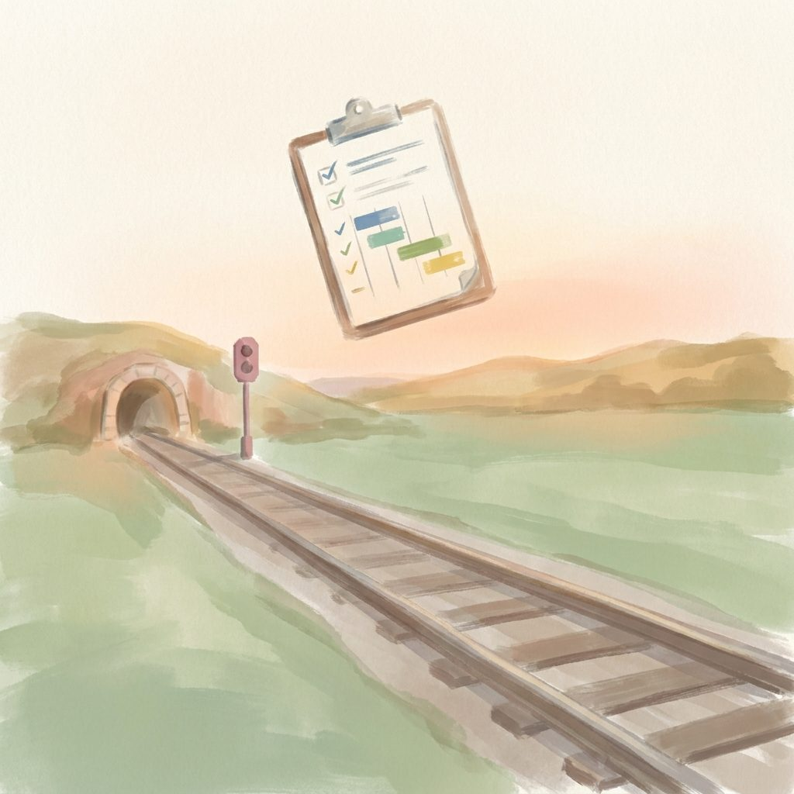
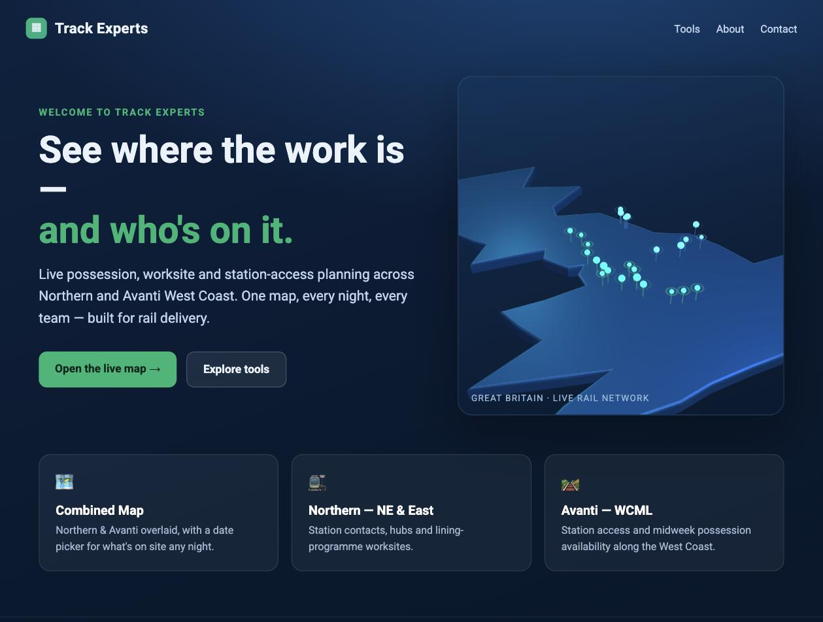
APP · DEEP DIVE
railplanning.tools
Commercial rail-access planning for Greater Anglia (CSS station maintenance).
COMMERCIAL
LIVE at railplanning.tools
Supabase project bokrkzyksnutlyzabpxp · TypeScript
STACK
Supabase Postgres · TypeScript apps · station_access_tags · possession_stations matcher · registers (ORF/ERAF, quote/PO)
HARDEST PROBLEM SOLVED
NOVEL CHOICES
Modelling the three-section access hierarchy (S4/S5/S7) as opportunities vs bookings; deduping cancelled protection-staff rows; keeping human-in-the-loop with 'edited' flags on auto-extracted station lists.
EAS/ARP + Network Rail week arithmetic (start Saturday) is a national NR construct — adding a new route is just loading its S4/S5/S7 sources against the same schema and tagging the stations. Rail is the quiet commercial track record funding the play studio.
hero render + live screenshot inset
LIVE

Slide 21
Reusable Pieces
The things that travel between apps

Slide 22
04 · REUSABLE PIECES
Deploy scripts & tooling
SCRIPTS THAT MATTER
VERIFICATION
scripts/deploy-3d.sh — one-liner Cloudflare Pages deploy of Story House 3D + friends/ + props/
scribe/cloud/deploy.sh — Worker deploy w/ pinned Whisper hash
code/walkabout-3d/FRIENDS-BUILD.md — the runbook. New friend? Follow the recipe: image→3D t-pose → remesh 120k → rig h=1.2 → animate.
Iskra deploy has a parse-and-STR-parity check: extract the <script>, new Function() to catch syntax errors, compare Object.keys(STR.en) vs Object.keys(STR.ru).
Browser verify = real renders and real taps — not synthetic .click(). This is a rule for every app.
'.reveal-who is CSS uppercase → assert textContent/innerHTML, not innerText' — the kind of gotcha we now write down.

Slide 23
05 · PERFORMANCE
Phone + tablet guardrails — non-negotiable
~10-30k
512px
tris per prop after remesh
texture size across the board
characters up to 120k → draco
keeps GLBs 0.3-1.5 MB each
~40-60MB
real phone
total scene budget on load
every performance change gets tested here
instance repeated props · lazy-load like the Friends picker
not desktop preview, not synthetic clicks

Slide 24
04 · REUSABLE PIECES
Shared 3D asset library — one asset, five games
1
2
3
4
5
Design once
Store once
Read many
Version
Sell later
Meshy image→3D + remesh + rig on a shared spec (h=1.2m human, ~10-30k tris prop).
Draco-compressed GLBs in a shared props/ + friends/ tree used by all apps.
Story House 3D, Café, Magic Shop, Kapibara, Sleeping Isles all import the same GLBs.
hero-* naming pattern per world (hero-palm, hero-gardentree) makes swap-and-deploy safe.
Same source assets can be packaged for itch.io / Sketchfab (verify Meshy commercial licence first).
This is what turns a 20-app portfolio into a 20-app studio.

Slide 25

Roadmap
Open problems worth collaborating on

Slide 26
06 · ROADMAP
This month's plan — 7,000 credits budgeted
~3,500 cr
Story House 3D flagship
3-4 new places · toy/food/vehicle/furniture prop library · dress-up wardrobe v1 · new characters + hug/jump/clap emotes
~2,000 cr
Shared library + 1 cross-game pilot
Pick ONE of Café / Magic Shop / Sleeping Isles and stand up its 3D using shared assets — prove the library travels
~500 cr
Sellable-prep
One polished showcase hero room + Higgsfield marketing renders + identify 2-3 asset-pack candidates
~1,000 cr
Iteration buffer
Meshy quality varies; budget for re-gens

Slide 27
06 · ROADMAP
Open engineering problems (come play)
Cross-origin shared toy store
Meshy output auto-compress
Magic Workshop and Story House 3D live on different origins. Need a small shared toy store the dollhouse reads so 'My toys' picker works.
Raw Meshy GLBs are bigger than our draco props. Auto-compress before promoting into the dollhouse — same pipeline, one flag.
Build World save + Meshy
Real-device perf harness
Add localStorage to Ari's Build World, then swap primitives for Meshy GLB pieces so she can request creatures Papa generates on demand.
"Test on a real phone" is a manual step. A minimal capture-tap-repro harness would let a subagent verify a build without David's hands.
Multi-route rail rollout
Duet ⇄ Iskra design audit
The rail pipeline is national-NR-generic. Adding a new TOC is loading its EAS S4 PDF + Section 5 + ARP maps against the same schema. Prime for a partner.
Two apps in adjacent territory. The boundary needs an audit + verdict page — some features want to live in only one.

Slide 28
06 · ROADMAP
How this actually gets built
THE LOOP
THE VALUES
Build → browser-verify (real renders / real clicks) → parse + parity check → deploy → confirm live.
Price the whole paid chain up front if there's a credit budget.
No invented scope. Memory files (memory/MEMORY.md and per-project *.md) carry state across threads so a new session picks up mid-build without replaying history.
Made for Arianna first, money second.
No dark patterns, no ads, no streaks in kid apps.
Cycle/reproductive data is sensitive — AI never attributes it.
API keys never touch the browser or git.
Peer-group dolls (family/friends) modelled from real people, treated respectfully.

Slide 29
APPENDIX · HIGGSFIELD RENDERS
Painterly-pastel hero library
35 Higgsfield renders were generated for these decks (Studio Ghibli meets Sago Mini, painterly-pastel brand palette).
Because the sandbox couldn't reach the CloudFront CDN to inline them into the .pptx binary, the deck ships with locally-rendered brand-consistent mockups.
Every Higgsfield job ID + URL is captured in Nova Code — Assets/higgsfield-manifest.txt so David can pull them into the deck (or reuse them elsewhere) any time.

Slide 30
CLOSING
Come build in this warm studio.
The pipeline is boring, the values are firm, the aesthetic is locked. It's the perfect substrate to add another app.
hello@ · davidmolan.eventexperts.online

