Slide 1
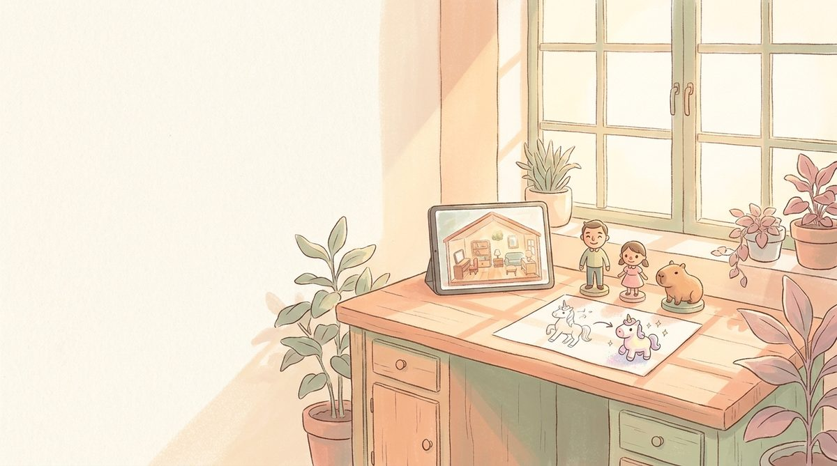
FOR THE INVESTOR · JULY 2026
Notes:
Investor deck. Open with the bet, then move quickly to portfolio breadth, unit economics, positioning, and the ask. ~30 slides.

Slide 2
THE BET · ONE LINE
A solo founder, a shared 3D asset library, and
a parent-ethical brand is a small studio.
20 apps live · Meshy MAX pipeline (10k credits/month) · Cloudflare-native · commercial rail-tech quietly funds the play studio

Slide 3
TL;DR
Executive summary
Product
20+ shipped apps across kids' play, couples, adult tools, and commercial rail-tech.
Flagship
Story House 3D — a walkable painterly dollhouse in the Toca Boca / Sago Mini category.
Pipeline
Meshy MAX + Higgsfield → drawings and photos become 3D toys and props. Reuse is the moat.
Distribution
Cloudflare Pages, Cloudflare Workers, Netlify (lovepapadavid). iOS TestFlight next.
Monetisation
Parent-paid content packs · saleable stylised 3D asset packs · commercial rail cash flow.
Team
Solo founder + AI copilot pipeline. Values-locked: no ads, no streaks, no dark patterns.
Ask
Small strategic raise or asset-pack licence deal to accelerate flagship + first paid launch.

Slide 4
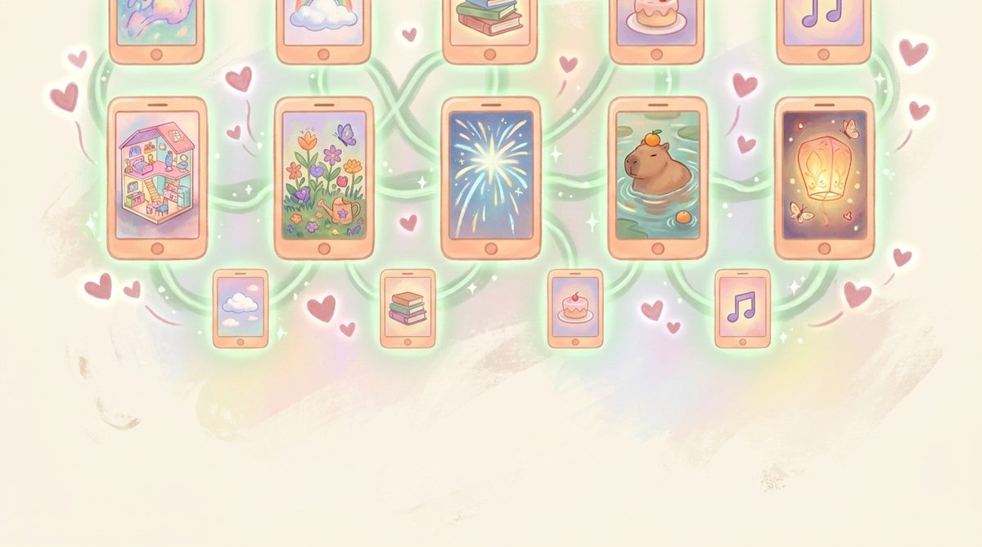
The Portfolio
20 apps live — one grid, one aesthetic

Slide 5
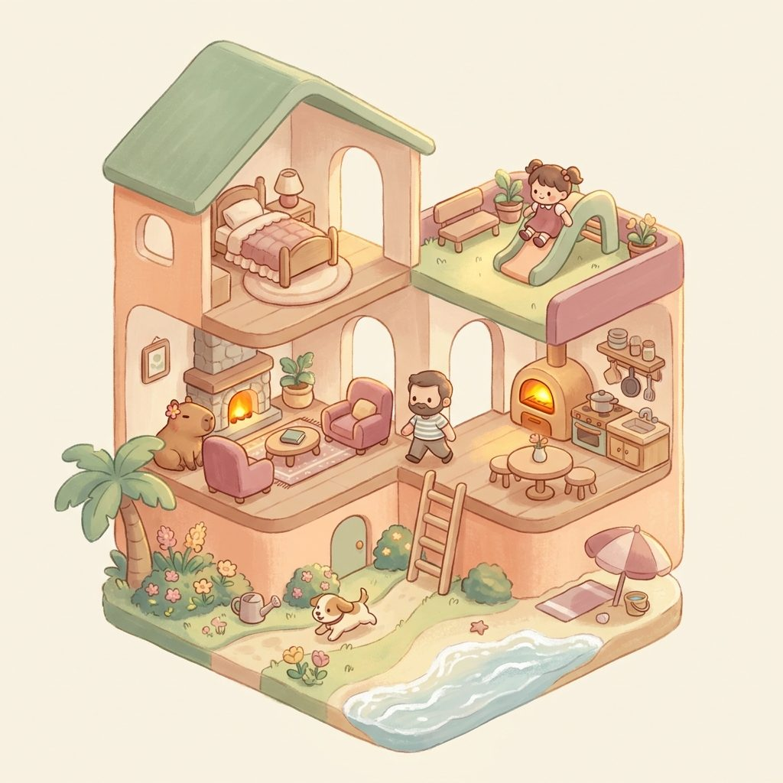
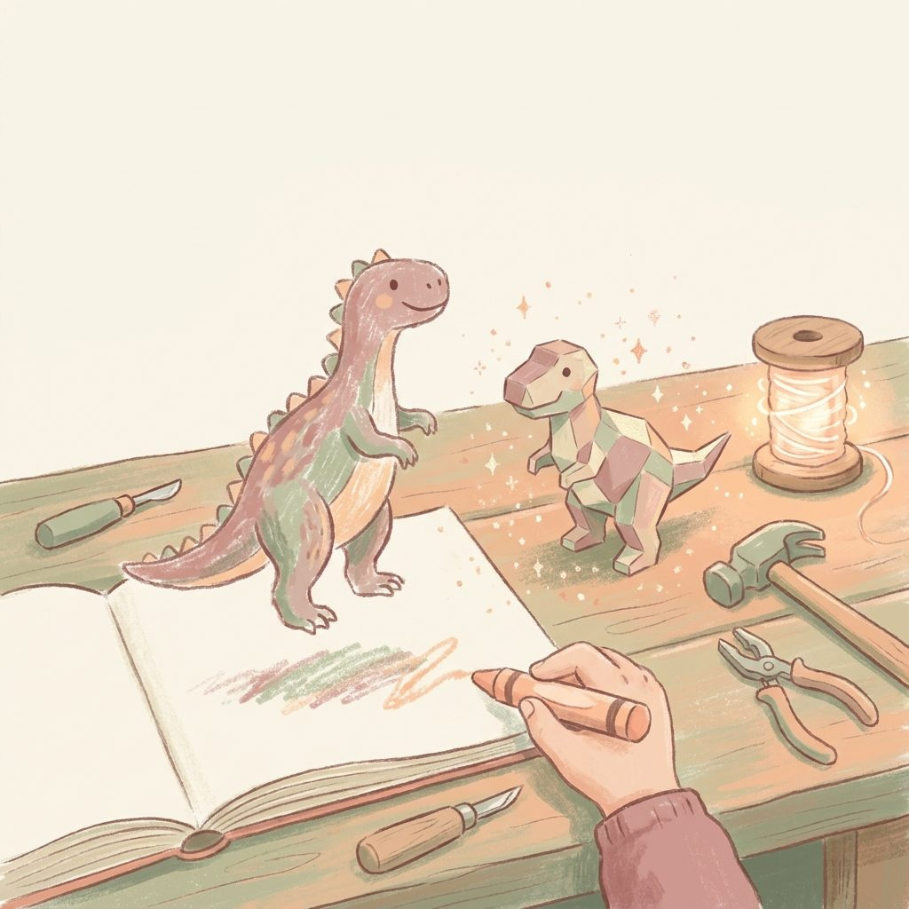
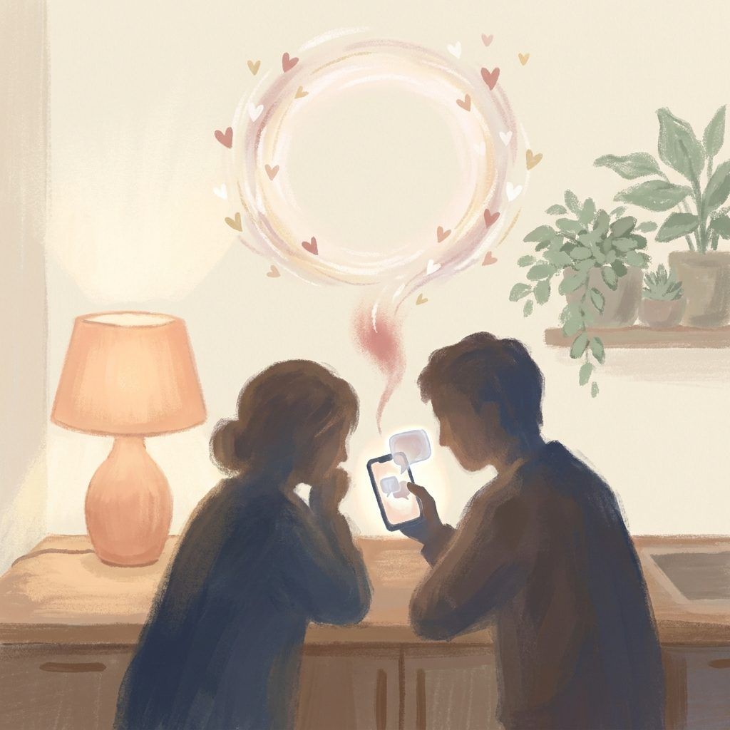
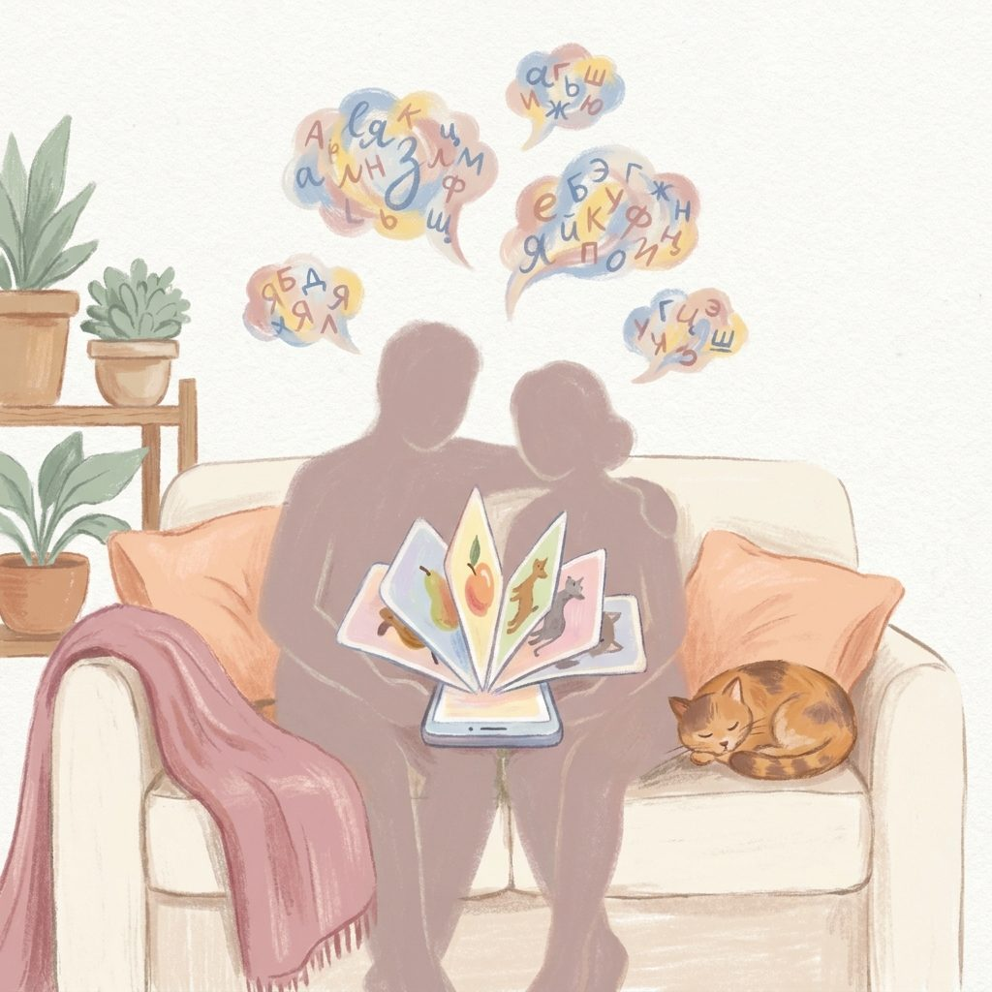



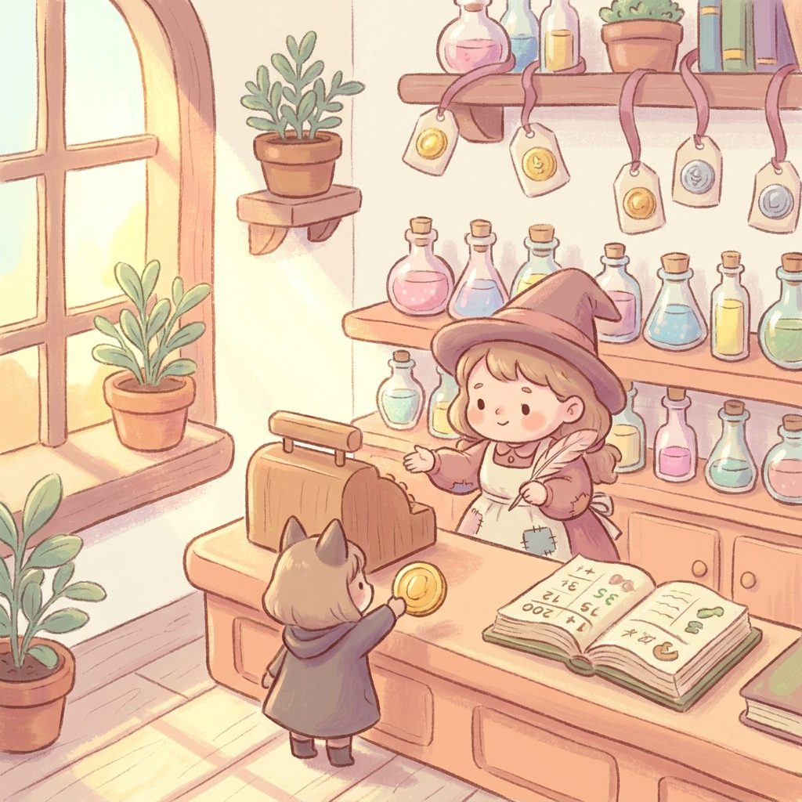

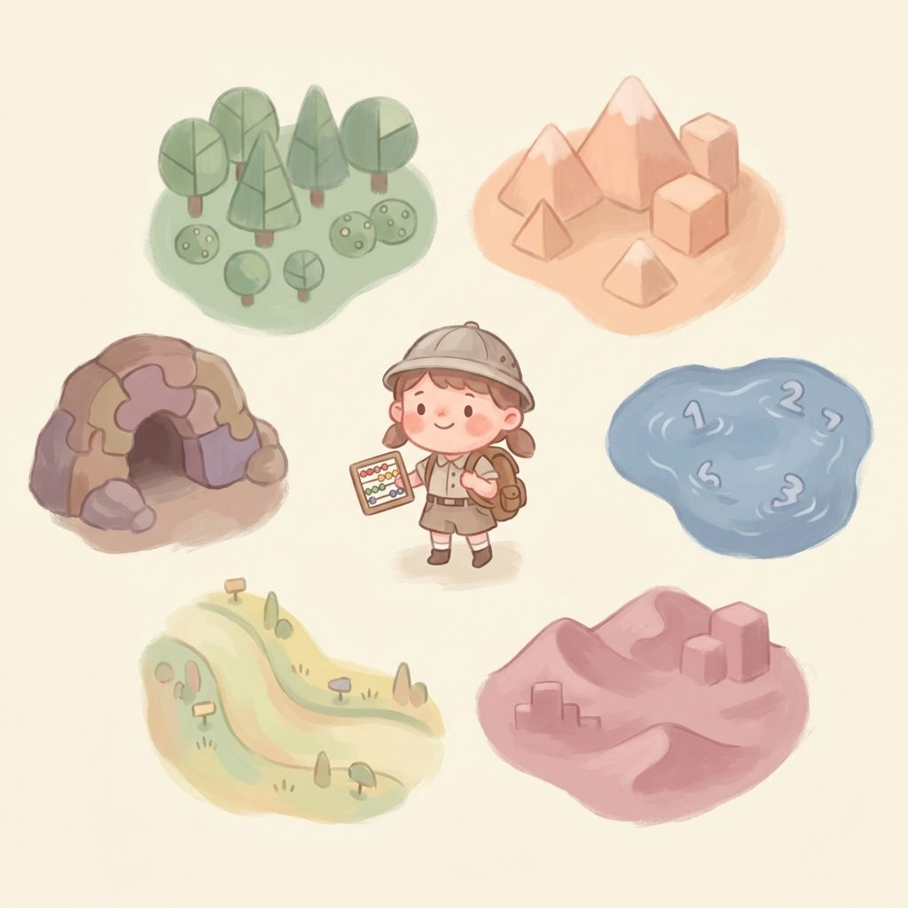

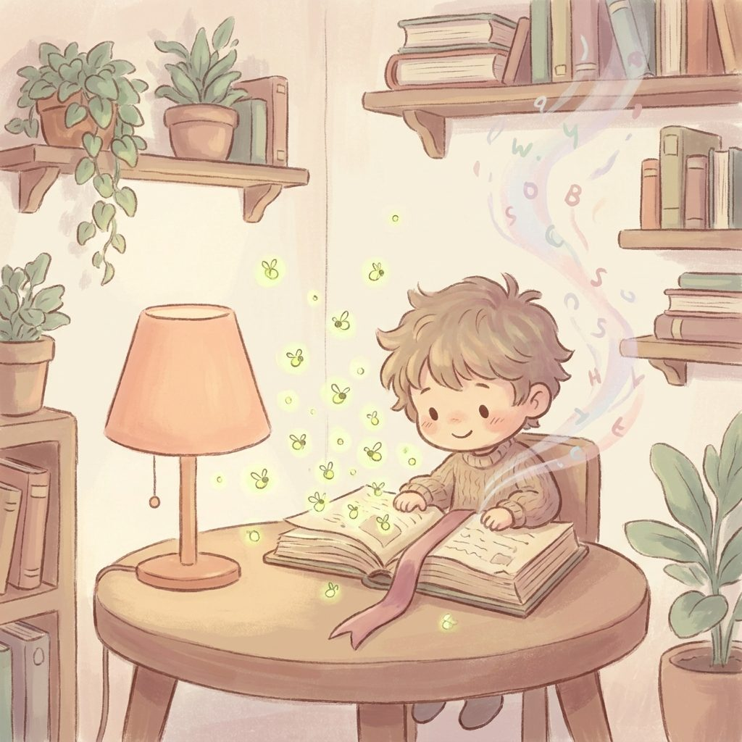
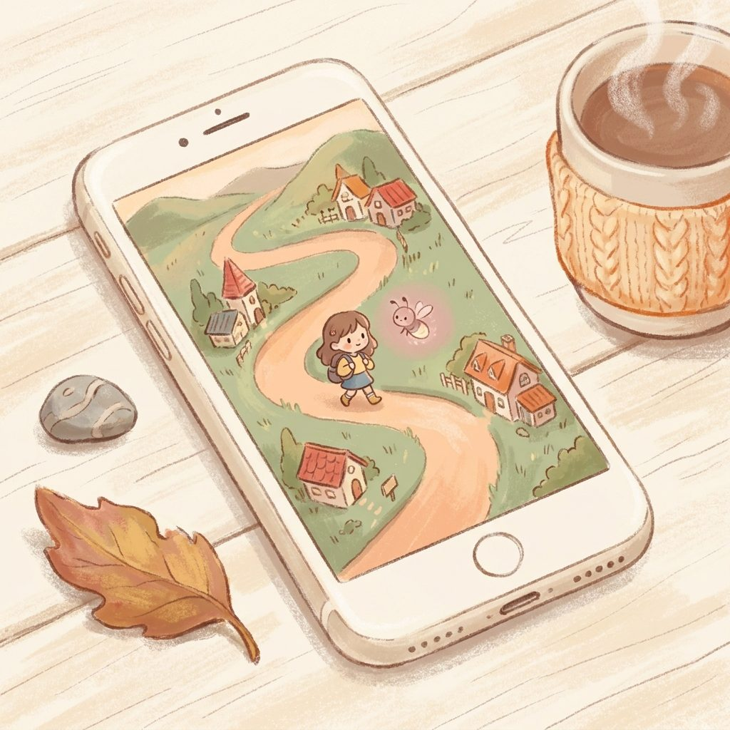

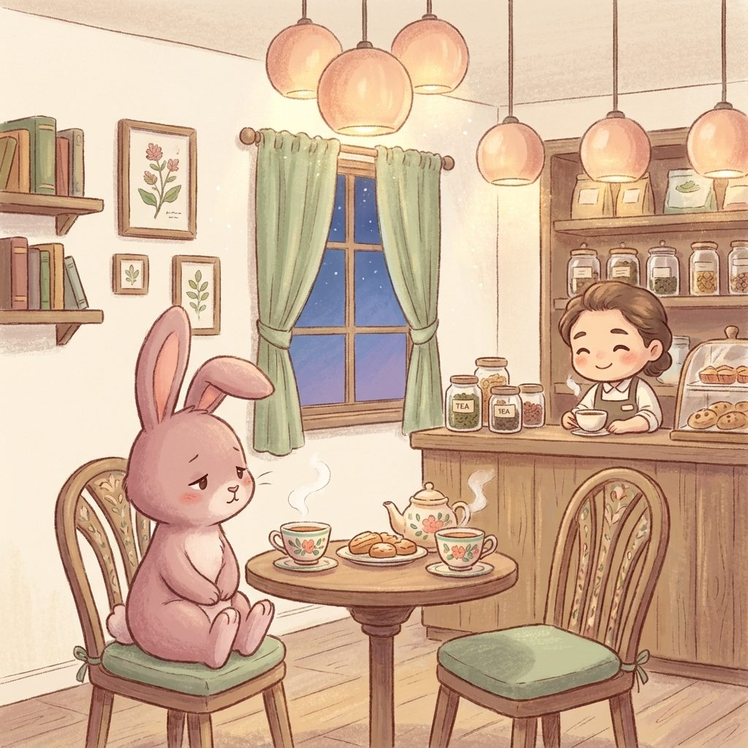
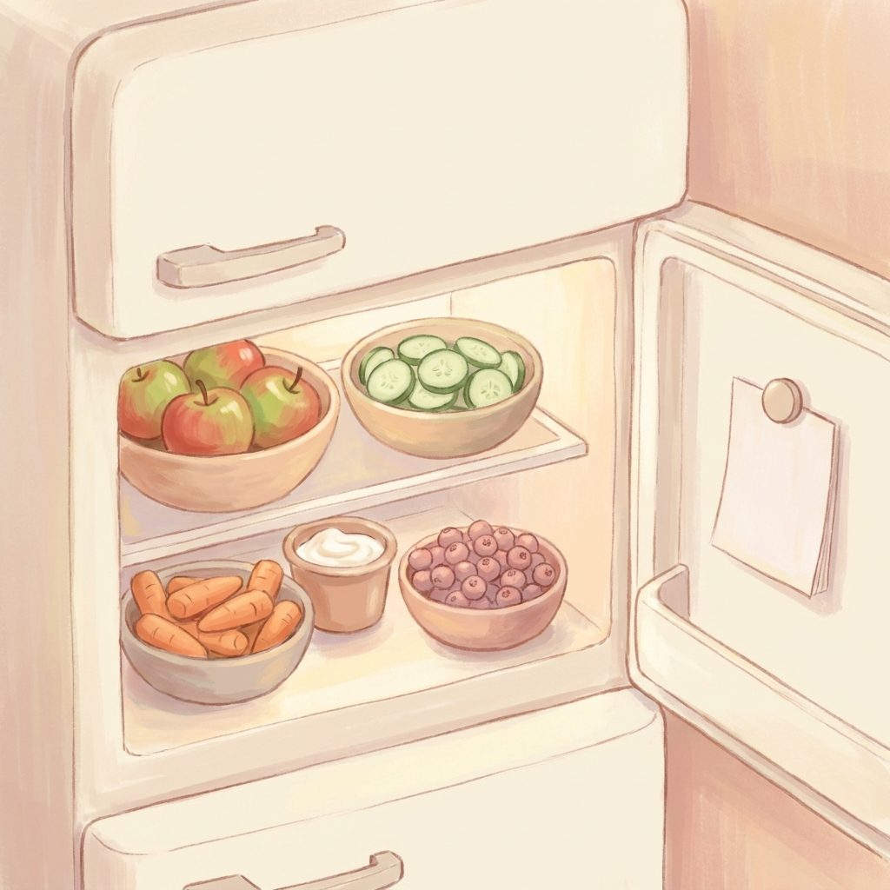

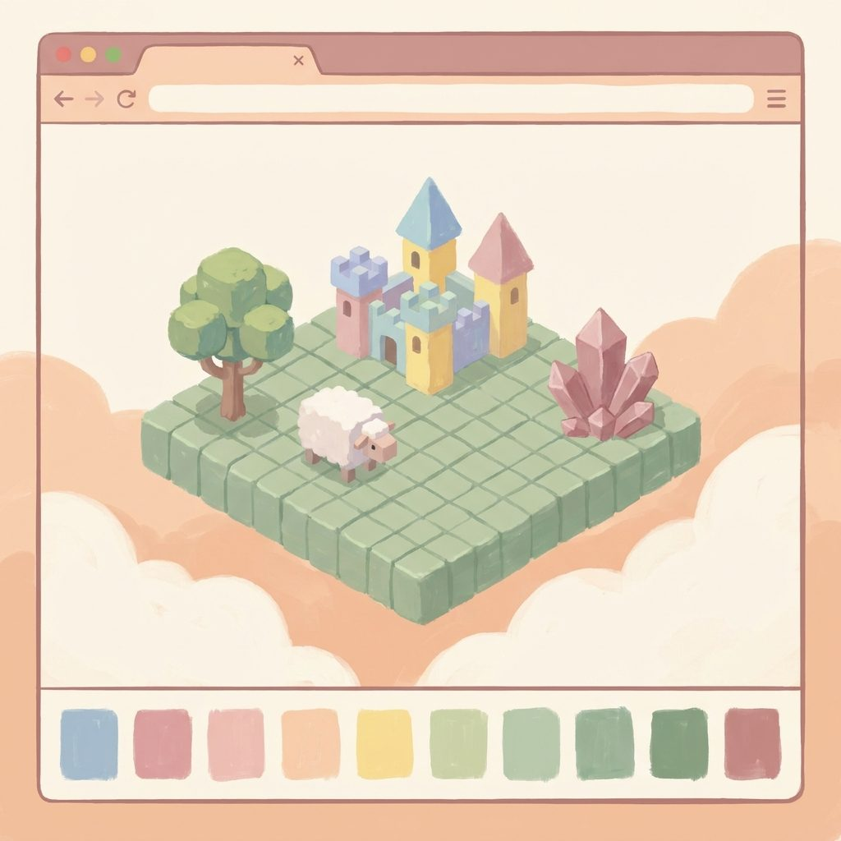

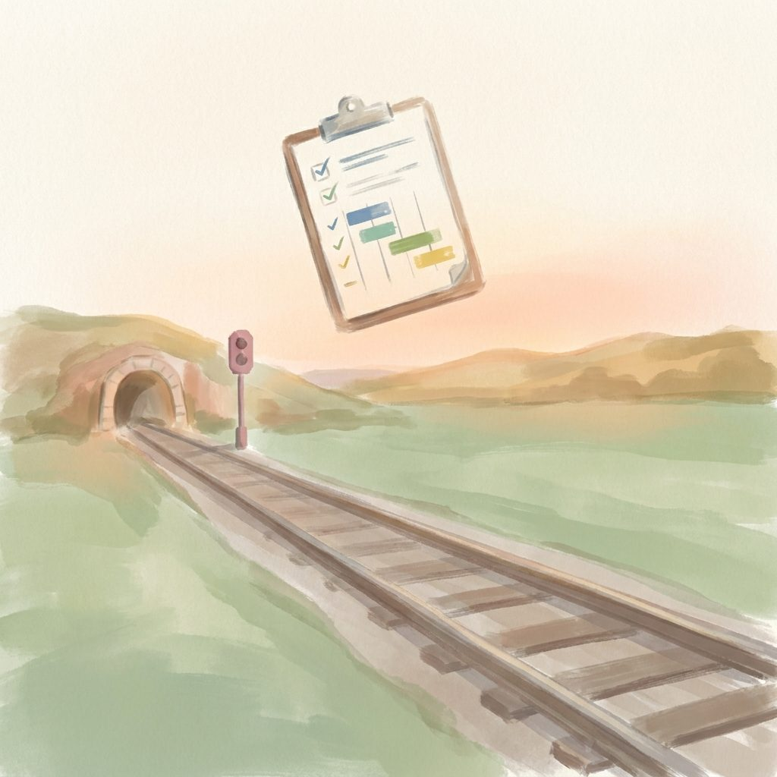
THE PORTFOLIO
One studio, one visual language
Story House 3D
Magic Workshop
Iskra · Искра
Duet · Дуэт
Scribe
Kapibara Book
Café
Magic Shop
Sleeping Isles
Maths Quest
Garden of Words
Firefly Reader
Walkabout
Lantern Keeper
The Hollow
Ari's Kitchen
Ari's Bookshelf
Build World
Travel Map
railplanning.tools
All live at Cloudflare Pages · Netlify · Cloudflare Workers

Slide 6
The velocity — six months, one person
20+
~6
~3.3
6+
apps shipped
months elapsed
apps/month cadence
categories covered
kids' play · couples · adult tools · commercial
solo founder + AI-copilot pipeline
single-file HTML apps, no build step for most
kids · edtech · couples · voice · commercial rail
Portfolio breadth is proof the pipeline is a studio, not a hobby.

Slide 7
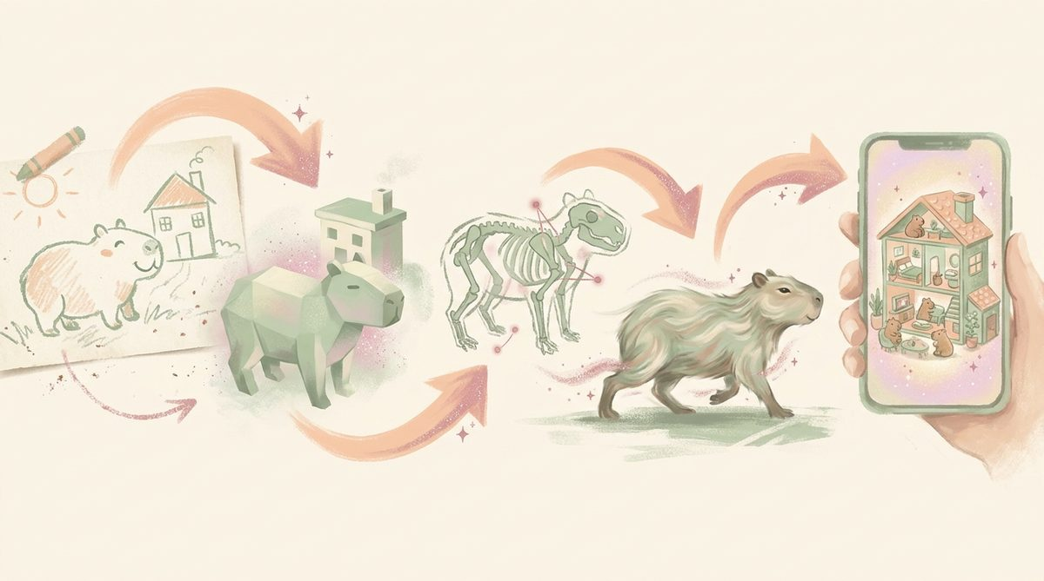
The Pipeline
Where the moat lives

Slide 8
Meshy MAX economics — credits are no longer the bottleneck
10k
~200
~300-400
~2
credits / month on MAX
fully animated characters
textured props / month
cr per source image
reversed the old "minimise spend" posture
at ~40-55 cr each (image→3D + remesh + rig + 3 anims)
at ~25-35 cr each (text→3D preview + refine)
Higgsfield when image→3D wins over text→3D
Art direction, wiring, and phone performance budget are now the real bottleneck.

Slide 9
THE PIPELINE
From a drawing to a phone-ready toy — repeatable
1
2
3
4
5
Source
3D-ify
Rig+animate
Compress
Ship
Photo of a child's drawing, OR a Higgsfield generated concept.
Meshy image→3D creates a t-pose model (~20 cr).
Remesh 120k tris · rig h=1.2m · 3 anims (wave/sit/dance).
gltf-transform 512px textures + draco → 0.3-1.5 MB GLB.
Load in three.js dollhouse OR export STL/OBJ for print.
Same pipeline drives Story House 3D · Magic Workshop · Café · Magic Shop · Kapibara.

Slide 10
THE PIPELINE
One asset, five games — why the library is the moat
PER-ASSET UNIT ECONOMICS
PLATFORM ECONOMICS
One capybara character: ~55 credits to create + rig + animate.
Reused across Story House 3D, Café, Magic Shop, Kapibara, Sleeping Isles.
Amortised cost per game: ~11 cr.
One prop (tree, food, chair): ~30 cr, similarly amortised.
Every new game reuses ~70% of the library, so the marginal cost of shipping game N+1 drops sharply.
Cloudflare Pages: free hosting for static apps.
Cloudflare Pages Functions: 100k free requests/day covers all current app traffic.
Cloudflare Workers KV: pennies for the couple-sync + own-device mirror volumes.
Supabase (rail): commercial tier, funded by rail contract.
COGS on kids' apps is dominated by AI credits, not hosting.

Slide 11

The Audiences
Four families, one studio

Slide 12
POSITIONING
Where each app family plays in the market
Family | Reference category | Apps in Nova Code | Adjacent brands
Kids' play | cozy 3D dollhouse · point-and-click adventure | Story House 3D · Sleeping Isles · Magic Shop · Café · Kapibara · Capybara Boom | Toca Boca · Sago Mini · Lil' Fluff
Kids' edtech | pedagogy games · slow-play literacy | Maths Quest · Firefly Reader · Garden of Words | Khan Academy Kids · Duolingo ABC · Homer
Kids' emotional | cozy · listening · loyalty | The Hollow · Lantern Keeper · Walkabout | Alba · Gris · Journey
Couples | bilingual RU/EN · NVC translator · together mode | Iskra · Duet | Paired · Between · Duolingo (adjacent)
Adult tools | voice capture · conversation aid | Scribe · Psy·Co·Parenting | Otter · Notion · OurFamilyWizard
Utilities | personal apps | Ari's Kitchen · Ari's Bookshelf · Suitcase · Travel Map · Adventure Jar | custom / bespoke
Commercial | rail access planning · station maintenance | railplanning.tools + tools/pages | Network Rail vendor tooling

Slide 13
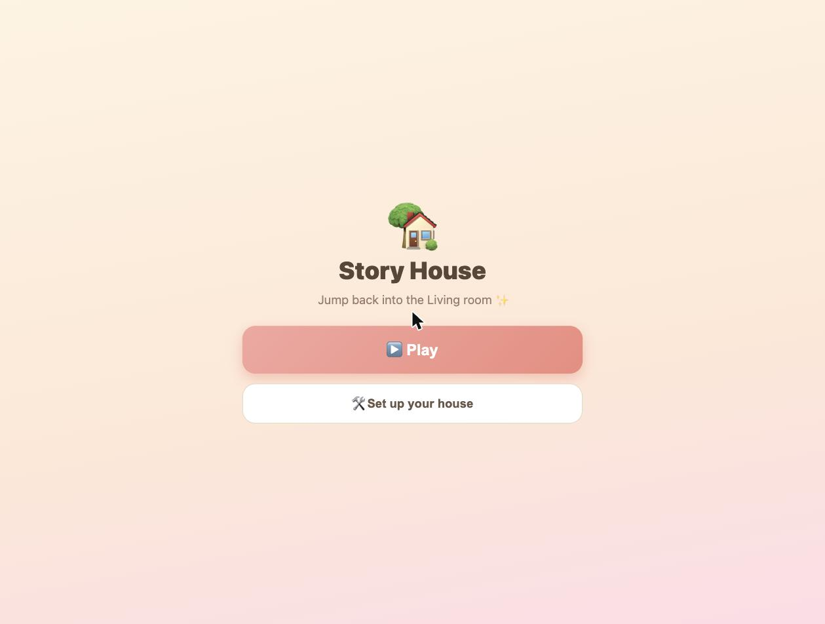
APP · DEEP DIVE
Story House 3D — the flagship
Walkable painterly dollhouse. Toca Boca / Sago Mini adjacency, 3D-native.
LIVE
LIVE at story-house-3d.pages.dev
story-house-3d.pages.dev
STACK
three.js r128 · Meshy pipeline · 38 friends · 6 places · day/sunset/night · dress-up wardrobe v1 in progress
HARDEST PROBLEM SOLVED
NOVEL CHOICES
Making a 3D dollhouse feel warm and painterly on a phone — flat-shaded style + animated water + gentle emote loops.
Real category. Real category with real revenue models (Toca Boca's parent Spin Master reports mid-$MM ARR on subscription kids' worlds). No dark patterns is a category differentiator, not just an ethic.
hero render + live screenshot inset
LIVE

Slide 14
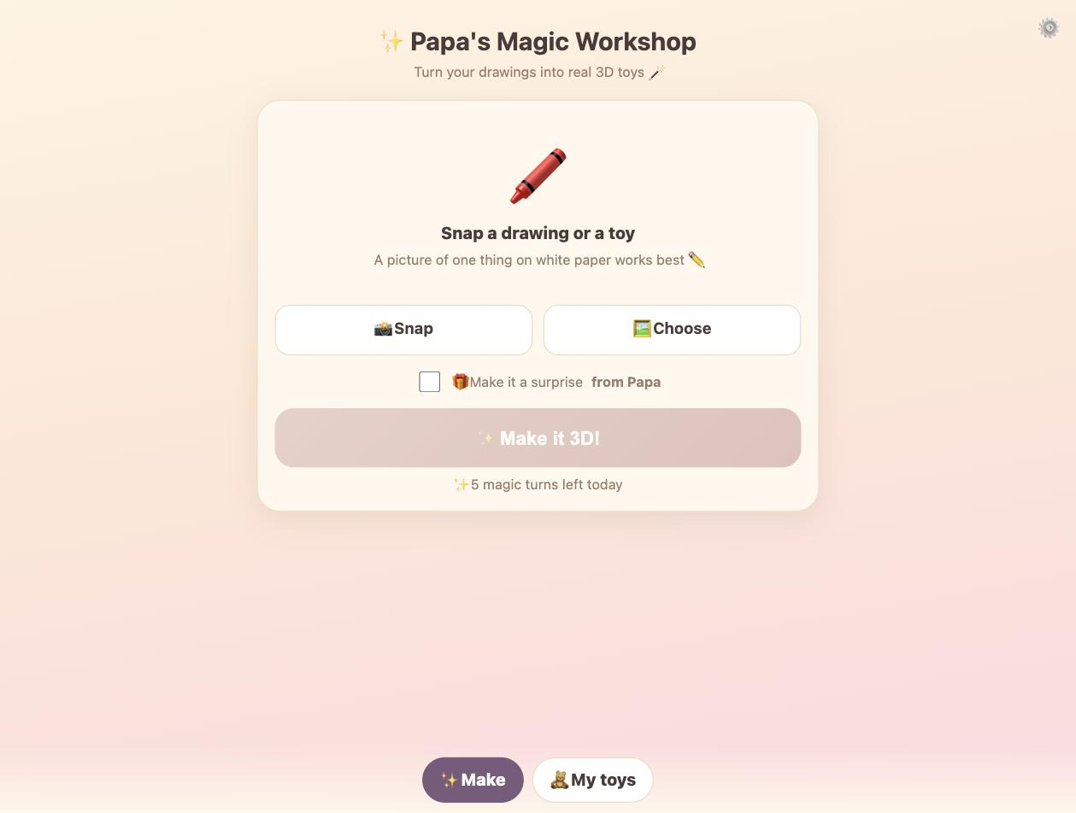
APP · DEEP DIVE
Papa's Magic Workshop
Drawings → 3D toys → print-ready. Novel + shareable.
LIVE
LIVE at magic-workshop.pages.dev
magic-workshop.pages.dev
STACK
Meshy image-to-3D · three.js viewer · IndexedDB toy box · STL/OBJ export for 3D print
HARDEST PROBLEM SOLVED
NOVEL CHOICES
Child-safety gating: instant daily magic-turn cap for Arianna, plus a 'surprise from Papa' toggle. Parent-gated settings behind a math gate.
The wow demo. Photograph a drawing → 60s later, a spinnable pastel 3D toy. Print it, drop it into Story House 3D as a playable toy. This is the shareable moment that TikTok / Reels loves.
hero render + live screenshot inset
LIVE

Slide 15
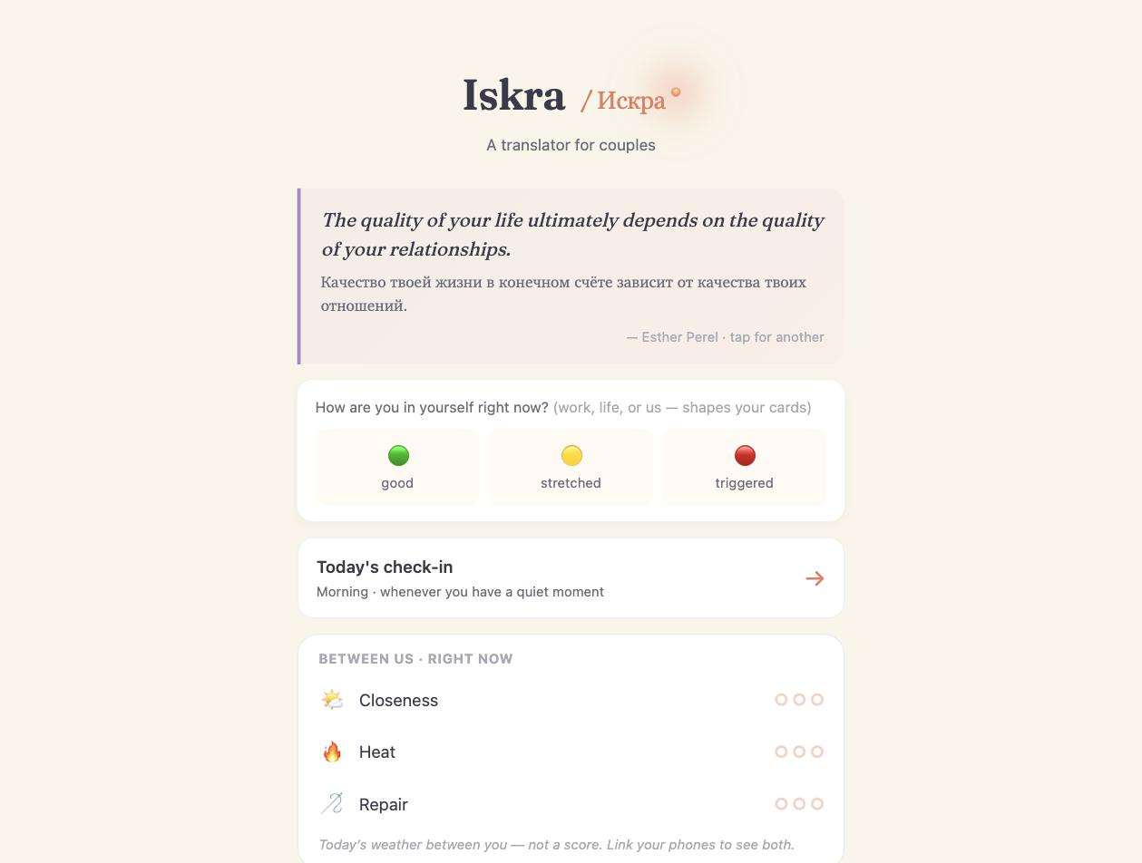
APP · DEEP DIVE
Iskra · Искра
Bilingual RU/EN couples app — a real product for a real market.
LIVE
LIVE at iskra.pages.dev
iskra.pages.dev
STACK
single-file HTML · Cloudflare Pages · KV sync · NVC translator + Together mode + Cycle & Rhythms
HARDEST PROBLEM SOLVED
NOVEL CHOICES
Three sync channels (couple link, own-device mirror, two-device live) — client-encrypted, KV-backed, all working today.
A bilingual couples app is a genuinely underserved niche (Paired and Between are English-only). RU/EN pair opens Cyrillic markets Duolingo-adjacent brands ignore. Same shared studio brand.
hero render + live screenshot inset
LIVE

Slide 16
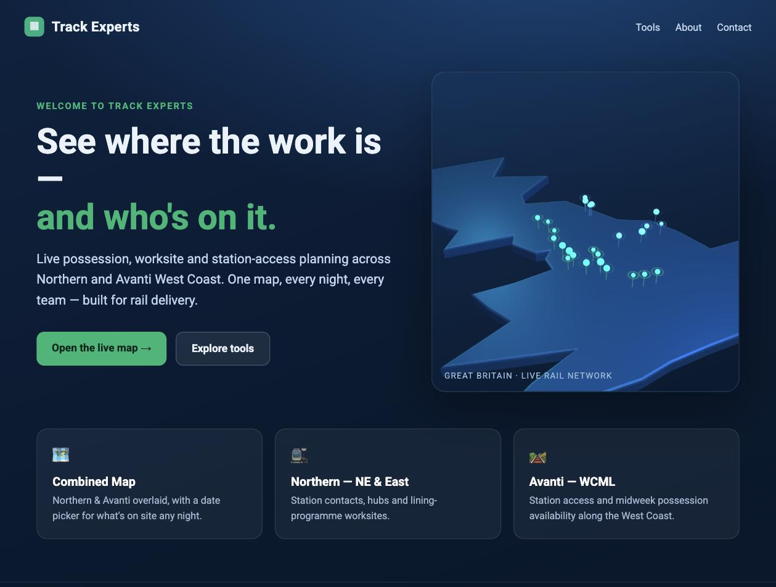
APP · DEEP DIVE
railplanning.tools — the quiet earner
Commercial rail-access planning for Carlisle Support Services (CSS) on Greater Anglia.
COMMERCIAL
LIVE at railplanning.tools
railplanning.tools
STACK
Supabase Postgres project bokrkzyksnutlyzabpxp · Section 4/5/7 access model · plan_items + budget + registers
HARDEST PROBLEM SOLVED
NOVEL CHOICES
Modelling Network Rail's three-section engineering access hierarchy (S4/S5/S7) as opportunities vs bookings with human-in-the-loop confirmation. National NR constructs, so any TOC can be added.
This is the reason the play studio exists. Commercial contract revenue funds the kids' apps and gives the founder runway that isn't dependent on hits.
hero render + live screenshot inset
LIVE

Slide 17
Traction
Live, running, monetiseable

Slide 18
TRACTION
Traction — what's already in the world
LIVE URLS (PUBLIC)
IN-DEV (LAUNCHING NEXT)
story-house-3d.pages.dev — the flagship
story-house.pages.dev — 2D dollhouse
magic-workshop.pages.dev — drawings→3D toys
iskra.pages.dev — the couples app
kitchen.david-c73.workers.dev — Ari's Kitchen
suitcase.david-c73.workers.dev — Suitcase
scribe.david-c73.workers.dev — Scribe (token-gated)
railplanning.tools — commercial
Sleeping Isles · Magic Shop · Café · Kapibara Book · Capybara Boom · Maths Quest · Travel · Hollow · Garden of Words · Walkabout · Lantern Keeper · Firefly Reader · Bookshelf · Adventure Jar · BriTannia'State · Duet · Psy·Co·Parenting · Arianna's Build World.
All on the same Cloudflare-first path — deployment is a scripts/deploy-3d.sh call away.

Slide 19
TRACTION · CREDIT USAGE
This month's spend, transparent
Line
Credits
%
What it delivers
Story House 3D flagship
3,500
50%
new places · prop library · wardrobe v1 · new characters + emotes
Shared library + 1 cross-game pilot
2,000
28%
stand up 3D in ONE of Café / Magic Shop / Sleeping Isles
Sellable-prep
500
7%
showcase hero room + Higgsfield marketing renders
Iteration / reroll buffer
1,000
14%
Meshy quality varies; budget for re-gens
July committed
7,000
100%
of 10,000 monthly credits (rollover reserved)

Slide 20
MONETISATION
Four revenue lines, all ethical, none dependent on ads
Parent-paid packs
$3–7 per pack
Story House 3D → room + outfit + character packs bought once by a parent. No IAP loops.
Asset packs (B2B)
$15–50 per pack
Sell stylised 3D asset packs on itch.io / Unity Asset Store / Sketchfab. Verify Meshy commercial-licence first.
Commercial rail
Contract revenue
railplanning.tools + tools/pages. Existing GA/CSS contract; national-NR generic so new TOCs plug in.
Studio play
Longer horizon
Portfolio of polished 3D games from one pipeline → a body of work a publisher or subscription could sit on.

Slide 21
DEFENSIBILITY
Defensibility — three quiet moats
THE ASSET LIBRARY
PARENT-ETHICAL POSITIONING
The reusable 3D asset library IS the moat. Every new app costs less because it borrows from the library.
A new entrant has to build up their library from scratch to compete — that's months of Meshy runtime and art direction.
The library is versioned per world (hero-* naming), so a swap is a one-line deploy.
No ads. No streaks. No IAP loops. Cycle/reproductive data (Iskra) is sensitive and AI never attributes it.
School-safe. Parent-safe. Grandparent-safe.
A hard positioning to copy without abandoning the mid-market that ads currently fund.
Combined with the painterly-pastel visual language, the brand is instantly recognisable.

Slide 22
COMPETITIVE LANDSCAPE
Where Nova Code sits (2026)
Player | Position | Nova Code angle
Toca Boca (Spin Master) | cozy 3D kids · subscription bundle | Same category, phone-first painterly, no subscription lock, sold as one-off packs to parents.
Sago Mini (Spin Master) | younger kids · cute + tap | Nova Code kids' apps target age 6-10 (the Toca Boca sweet spot), not toddlers.
Duolingo Family/ABC | streak-driven edtech | Deliberate anti-streak play — the app should be forgettable for a week without punishing the kid.
Duolingo (adjacent) / Paired | couples relationship | Iskra is bilingual RU/EN first — Cyrillic-language couples are underserved by every English-only brand.
Otter.ai | voice notes | Scribe is local-first (IndexedDB), token-gated, model-picker exposed (Haiku→Sonnet→Opus). No enterprise cost.
Custom bespoke rail tooling | Network Rail vendor tools | railplanning.tools models the NR constructs (S4/S5/S7 · NR weeks) so it plugs into any TOC route — not GA-specific.

Slide 23
TEAM
The team — solo, but not alone
TODAY
WHAT UNLOCKS WITH FUNDING
One founder: David Molan.
Background: commercial rail contracts + full-stack engineering + 20+ shipped apps across kids' play, couples, adult tools, and commercial rail.
AI copilot pipeline: Claude for build, Meshy for 3D, Higgsfield for renders, Replicate for Whisper.
Fully operational solo studio.
1 · A contract artist (part-time) to finish the painterly-pastel Story House 3D asset library.
2 · A part-time developer for iOS TestFlight packaging + native shell.
3 · A community/PR lead for the parent-testimonial angle.
All on independent contracts, keeping the values-locked solo-founder shape.

Slide 24
Sketch of the year ahead — indicative
~£0
£1-2k
Rail
Play
cost of goods on kids' apps
monthly AI-credit budget
existing contract revenue
packs + assets = upside
hosting is essentially free at current volume
Meshy MAX ~£300 + Anthropic/Higgsfield/Replicate
covers the founder's runway today
the pastel studio is the asymmetric bet
This is a runway-preserving, upside-shaped studio — not a hits-or-death game.

Slide 25

The Ask
Small strategic capital, big optionality

Slide 26
THE ASK
What we're raising and what it unlocks
35%
Story House 3D flagship completion
Painterly asset library push + wardrobe v1 + iOS TestFlight packaging
25%
Magic Workshop shareable launch
TikTok/Reels seed content + press outreach + parent-testimonial pilot
20%
Asset-pack pilot on itch.io / Sketchfab
Package the shared 3D library into 3 saleable packs · verify licence path
10%
Iskra couples paid launch
Ship Cyrillic-market Together mode + call-bridge voice + first paid tier
10%
Runway buffer
Legal (licence review) + accounting + one small hardware fund for 3D printing thread

Slide 27
MILESTONES
6-month plan — where the money goes to work
1
2
3
4
5
Month 1
Month 2
Month 3
Month 4
Month 5
Painterly asset library push · Story House 3D new places + wardrobe v1
Magic Workshop TikTok/Reels launch content · parent testimonial pilot
iOS TestFlight for Story House 3D + Magic Workshop
Asset-pack #1 shipped on itch.io / Sketchfab · licence path verified
Iskra call-bridge live · first paid tier · Cyrillic-market launch
Each milestone is a fully shippable state — no all-or-nothing gates.

Slide 28
RISKS
What we're watching
Meshy licence
Using Meshy models in our own games = fine on paid plans; reselling raw generated assets in a pack may be restricted. Legal review before Asset-pack #1.
Solo founder concentration
One person is a real risk. Mitigation: memory-file discipline + AI copilot pipeline so a paused build resumes cleanly; contract artist/dev/PR planned via funding.
App-store gating
iOS TestFlight is the near-term path — no app-store submission yet. Cloudflare Pages is the fallback distribution and doesn't require a gate.
Attention economy
Parent-ethical positioning is a strength but also a slower go-to-market than ad-monetised apps. Content strategy (Magic Workshop TikTok / Reels) is the counter.

Slide 29
WHY NOW
Why now
THE PIPELINE JUST GOT REAL
THE MARKET IS QUIETLY MOVING
Meshy MAX @ 10k credits/month arrived. The pipeline is proven, the library is beginning to travel, the flagship is genuinely playable.
The last six months were 'can this work'. The next six are 'how far does this go'.
Toca Boca / Sago Mini have consolidated under Spin Master. Parents actively want alternatives that aren't ad-driven.
The Cyrillic-language couples market is underserved by English-only apps.
Rail contract cash flow means the play studio has runway that isn't hits-dependent — a rare shape.

Slide 30
CONTACT
Let's build a quiet studio, together.
David Molan · davidmolan.eventexperts.online · david@eventexperts.online
UK-based. Available for calls Tue/Thu. All live URLs in appendix.
· BUILT BY A PAPA · POWERED BY A PIPELINE ·

