Slide 1
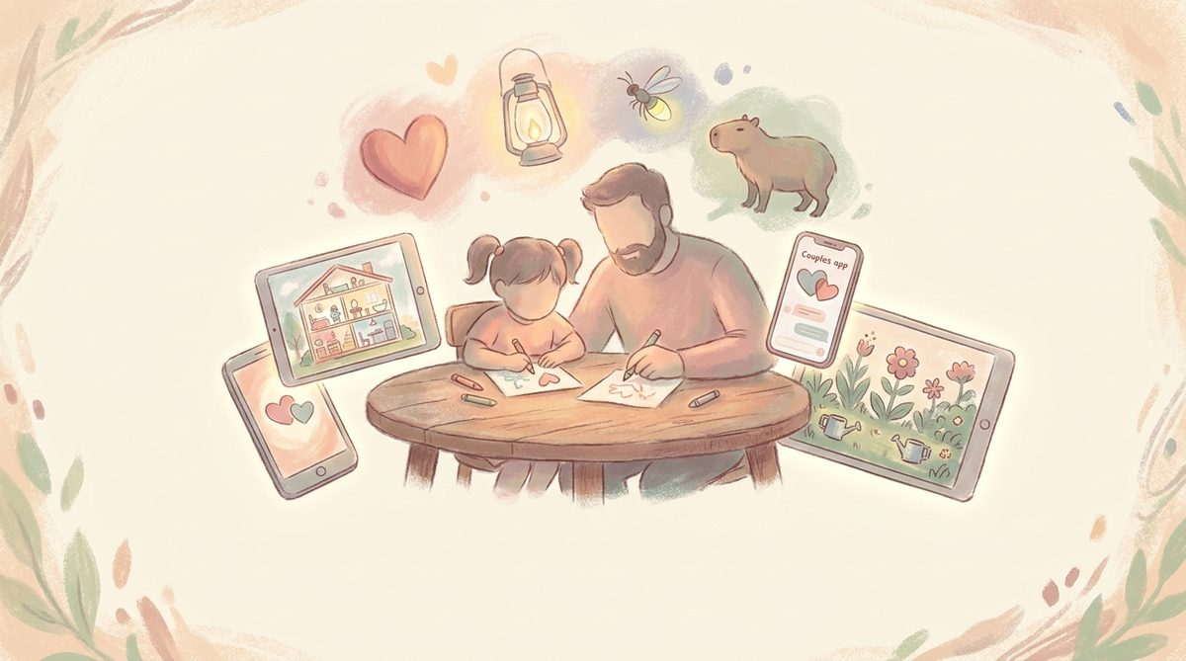
FOR THE MARKETER · BRAND, POSITIONING, REACH

Slide 2
THE ETHOS · ONE LINE
Built by a papa, for his daughter first.
Money second.
Every decision runs through that filter — no ads, no streaks, no IAP loops. A parent-safe warm studio for phones and tablets.

Slide 3
BRAND · PALETTE
The five colours of Nova Code
Cream
Warm peach
Sage
Dusty rose
Ink
#FBF5EA
#F6C6A4
#B8CFB0
#E5A9B3
#2A2A2E
background · calm
warmth · welcome
growth · nature
heart · connection
type · edge
Cream dominates ~60% of any surface. Peach and sage carry warmth and calm. Dusty rose is our accent — used sparingly for the beat of a story. Ink is our type.

Slide 4
BRAND · TYPE
A warm serif for headings.
A clean sans for everything else.
Cambria · warm humanist serif
Built by a papa, for his daughter first.
Calibri · clean, humanist sans (Inter / Manrope substitutes in production)
The daily voice of the studio — friendly, readable at 14pt on a small phone, never precious.

Slide 5

The Stories
Four threads that make one studio

Slide 6
STORIES · 01
Story 1 · A papa building for his daughter
THE THREAD
WHY IT MARKETS
Every kids' app starts with a real conversation with Arianna (age 8.25). Story House 3D began with 'I want a dollhouse I can walk in'. Papa's Magic Workshop began with 'I want my drawings to be real toys'. Arianna's Build World began with 'I like Minecraft'.
The apps are made for her first. The rest is upside.
This is the single most powerful thread. Parents recognise the tone: it's the same tone they'd want to build for their own children.
The brand doesn't have to explain 'no ads' — the origin story does that in one sentence.
TikTok/Reels loves it: dad building for daughter is an evergreen format.

Slide 7
STORIES · 02
Story 2 · Couples finding their language
THE THREAD
WHY IT MARKETS
Iskra (Искра) — a bilingual RU/EN couples app. Not a translator. A translator plus an NVC (nonviolent communication) framework, a Together mode where both phones lock to one card, and a Cycle & Rhythms feature that keeps sensitive data opt-in.
Duet is its calmer cousin: a couple learning each other's language, gently.
Cyrillic-market couples are massively underserved by Paired / Between / Duolingo Couples.
The 'spark between two languages' visual (a small pastel spark rising between silhouetted figures) is the entire brand in one image.
Same studio, different lane — the pastel palette carries.

Slide 8
STORIES · 03
Story 3 · Painterly-pastel worlds
THE THREAD
WHY IT MARKETS
Every app looks like it was painted by the same warm hand. Same five colours. Same rounded, humane geometry. Same generous whitespace.
Story House 3D dollhouse; Sleeping Isles floating dream isles; Garden of Words growing plants; The Hollow's tearoom. Different games, one visual language.
The aesthetic is instantly recognisable — a rare thing in kids' app stores dominated by neon.
The visual mood does the emotional pre-selling: 'this is safe, this is warm, this is made by someone who thinks about their child'.
Sago Mini owns cute. Toca Boca owns bright. Nova Code owns painterly.

Slide 9
STORIES · 04
Story 4 · Commercial rail quietly funding the studio
THE THREAD
WHY IT MARKETS
railplanning.tools models Network Rail's engineering access hierarchy (Section 4/5/7) for Carlisle Support Services on Greater Anglia.
Commercial software revenue underwrites the play studio. National-NR constructs mean the same tooling plugs into any TOC route.
Not a public-facing story, but it's the one that gives everyone confidence: this is a founder who ships commercial software today, not a hobbyist.
Use it in investor pitches and in trade press. Keep it out of consumer marketing.
It's proof that the pastel studio isn't a bet-the-farm play.

Slide 10

The Audiences
Who each app family is for

Slide 11
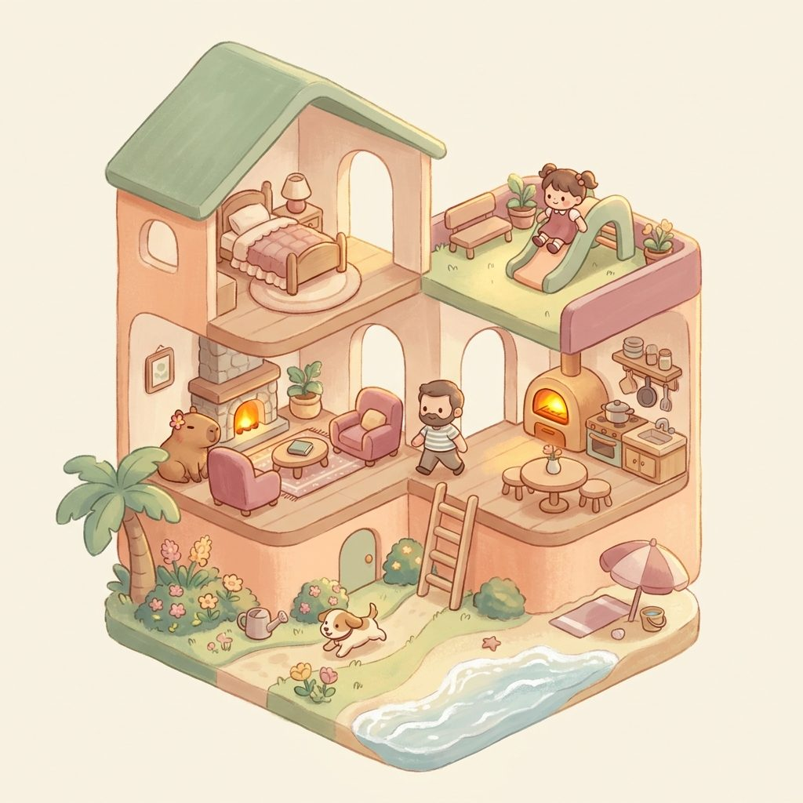
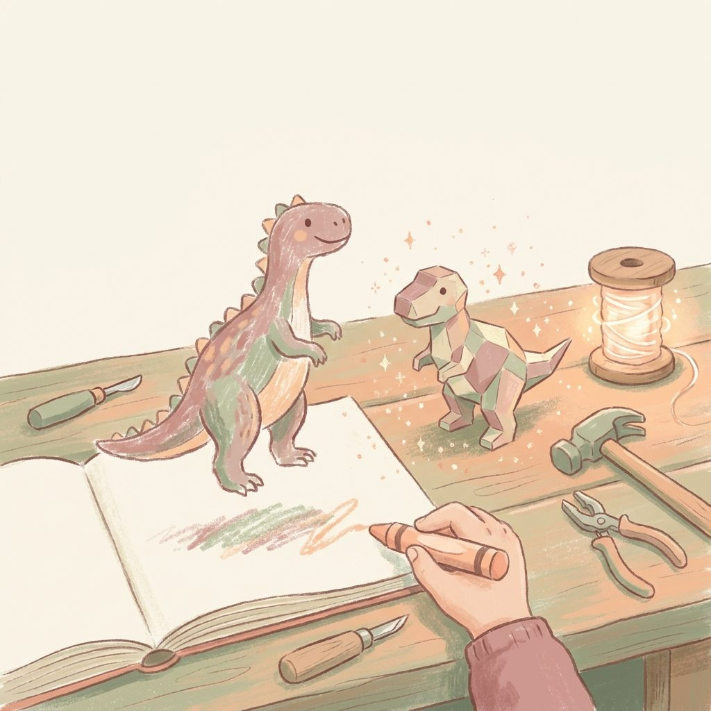

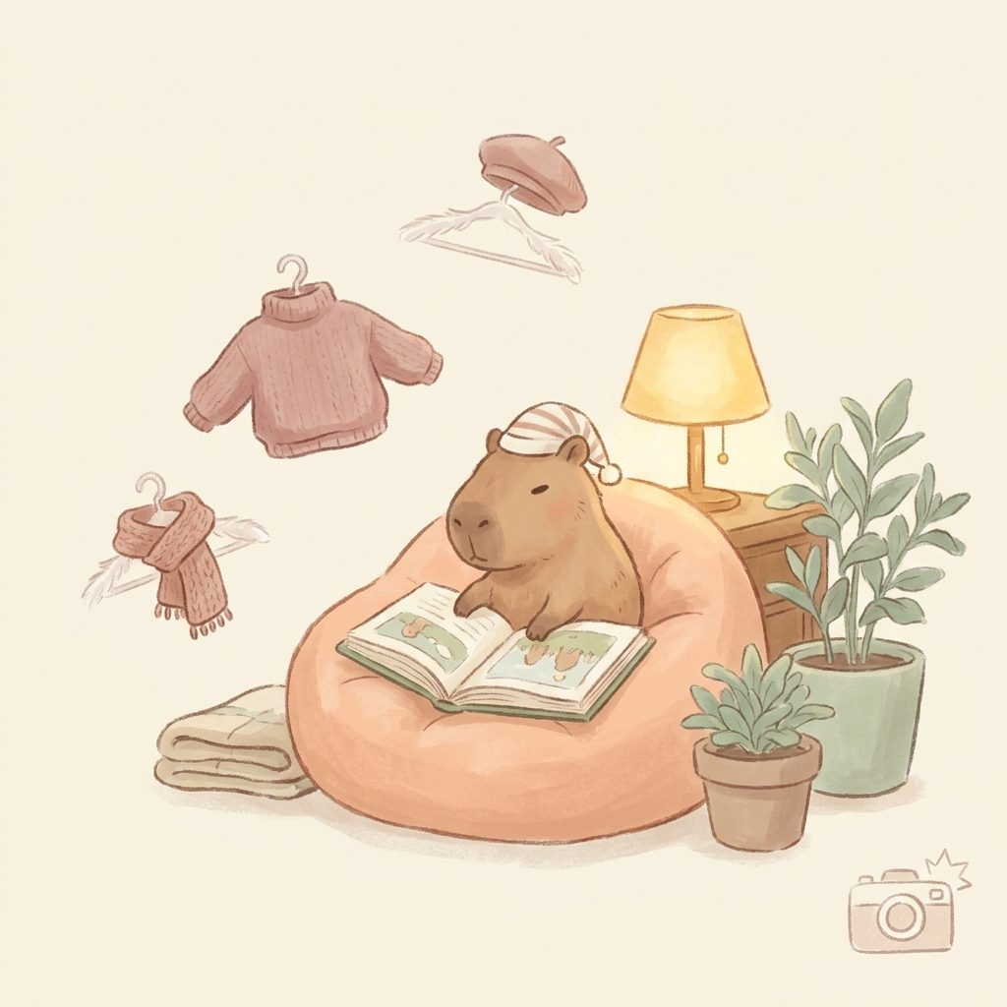
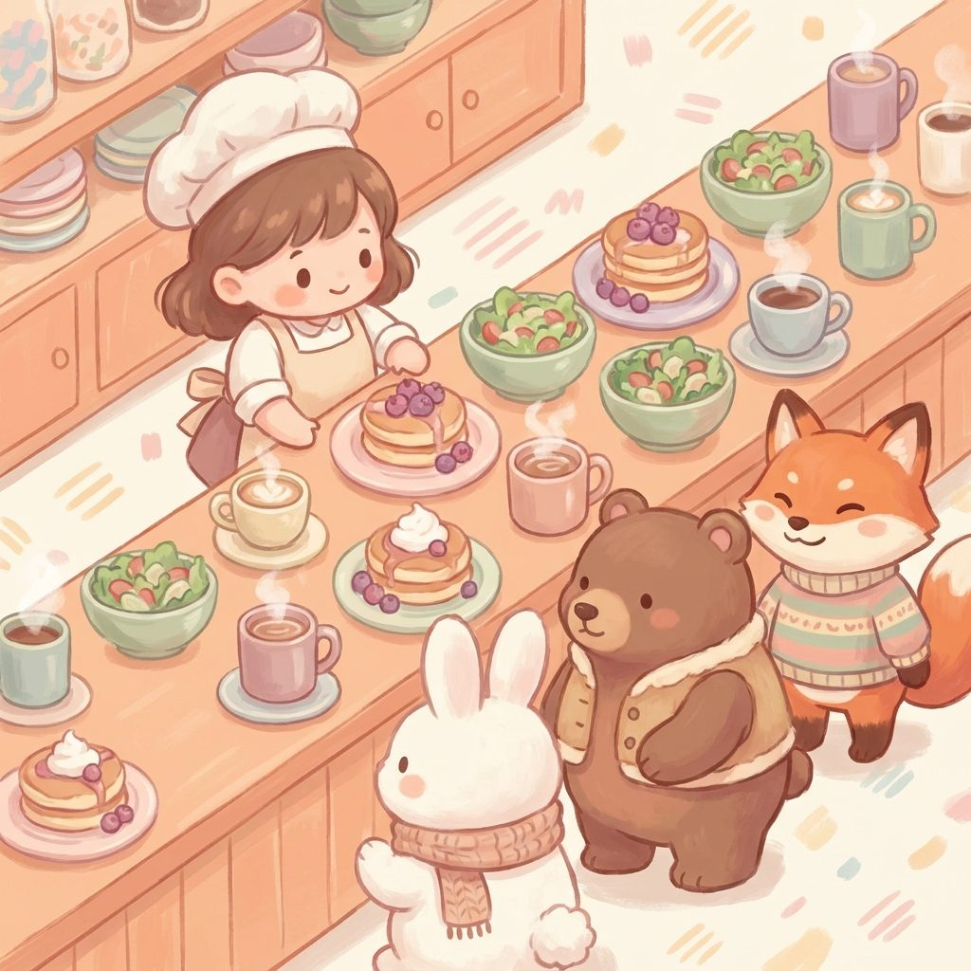
AUDIENCE · KIDS & FAMILY
Kids' play — the flagship family
Who
What they love
What they buy
Parents of children aged 6-10 who want cozy, imaginative play without ads, streaks, or paid-loot dark patterns.
Painterly worlds they can wander in. Storybook feel. Their child asking 'can I play the papa game?'.
One-off packs (rooms, outfits, characters) at $3-7. No subscriptions.
APPS IN THIS FAMILY
Story House 3D
Magic Workshop
Sleeping Isles
Kapibara
Café

Slide 12
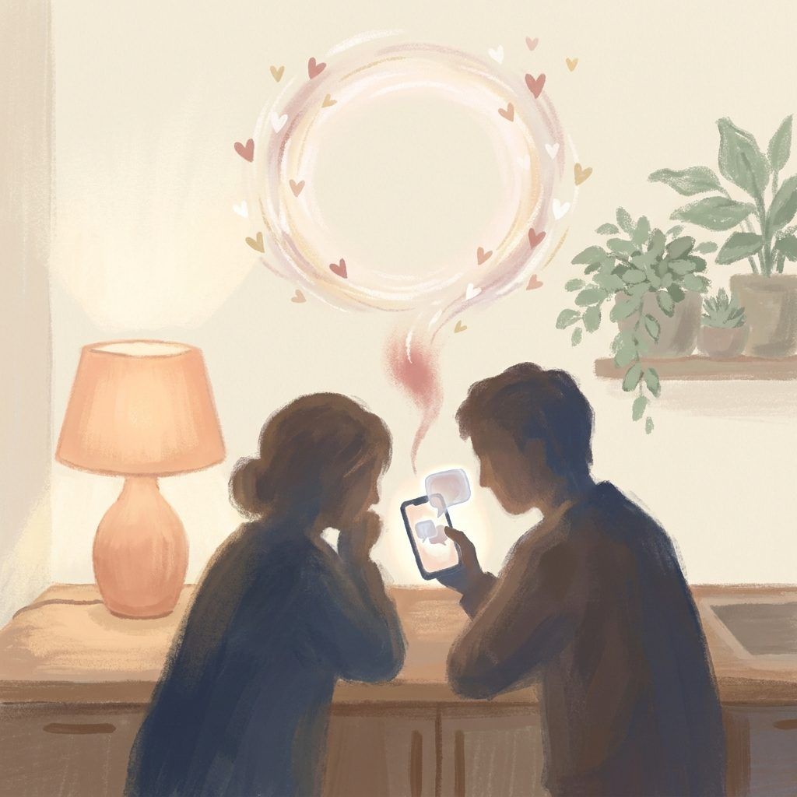
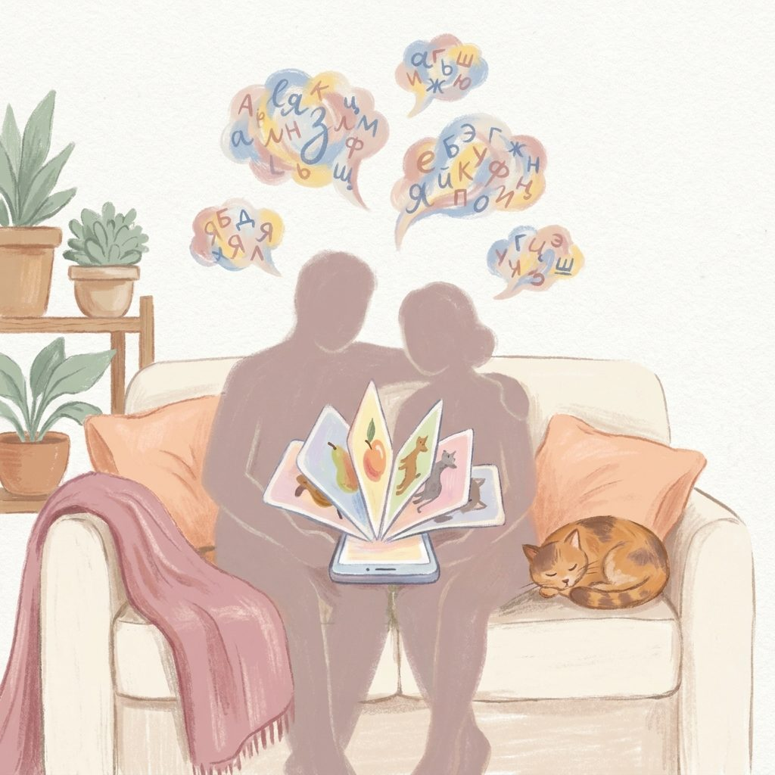
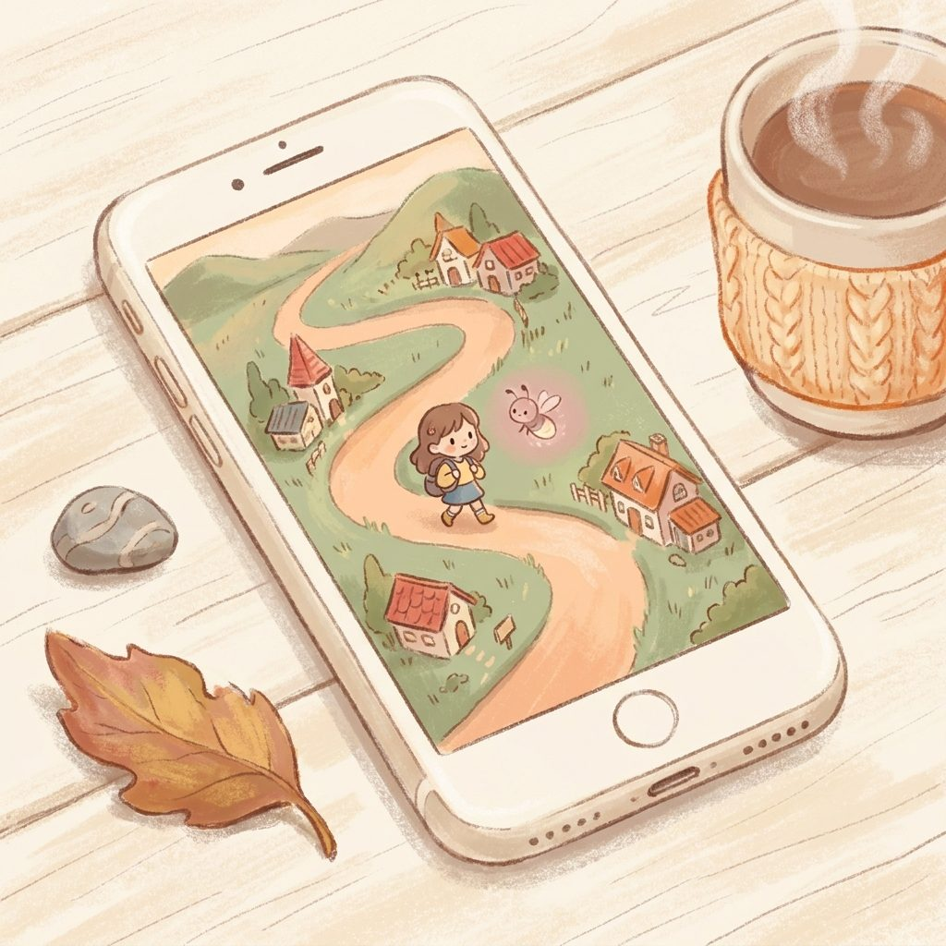
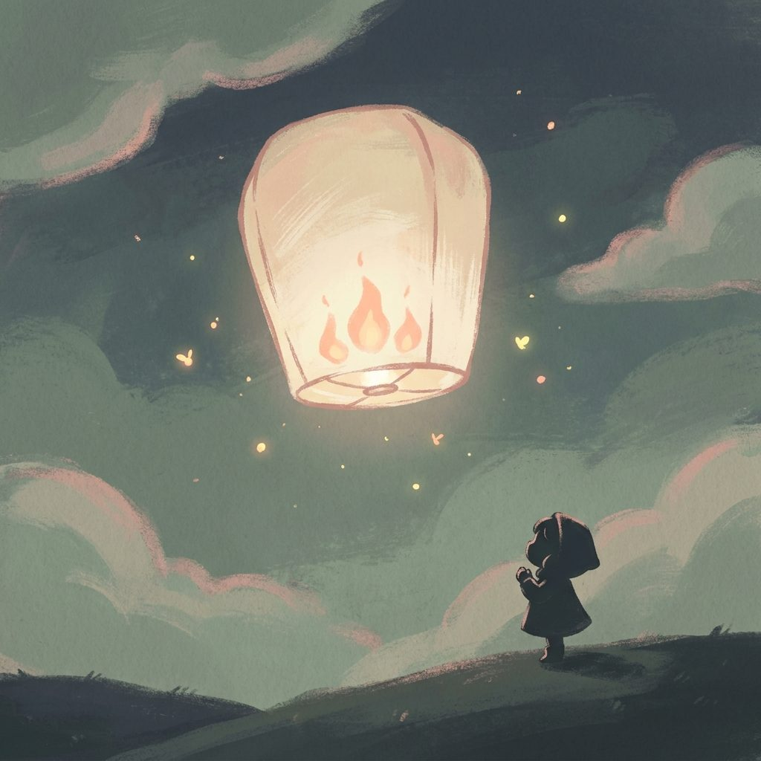
AUDIENCE · COUPLES
Couples — the bilingual angle
Who
What they love
What they buy
Adult couples, especially Russian-English pairs, looking for a warmer connection tool than the streak-driven mainstream.
The 'Together' mode where both phones lock to one card. The NVC translator that softens hard messages.
A gentle paid tier for couple sync + advanced Together. First paid launch: Q3 2026.
APPS IN THIS FAMILY
Iskra · Искра
Duet · Дуэт
Walkabout
Lantern Keeper

Slide 13
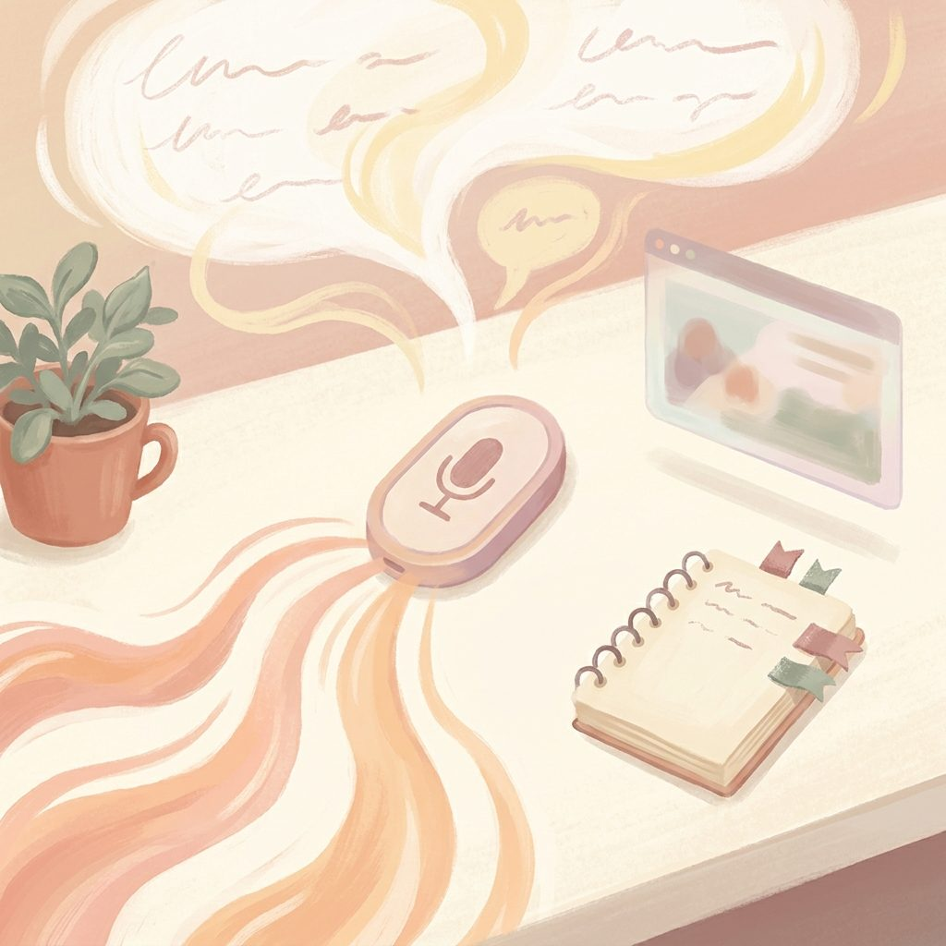

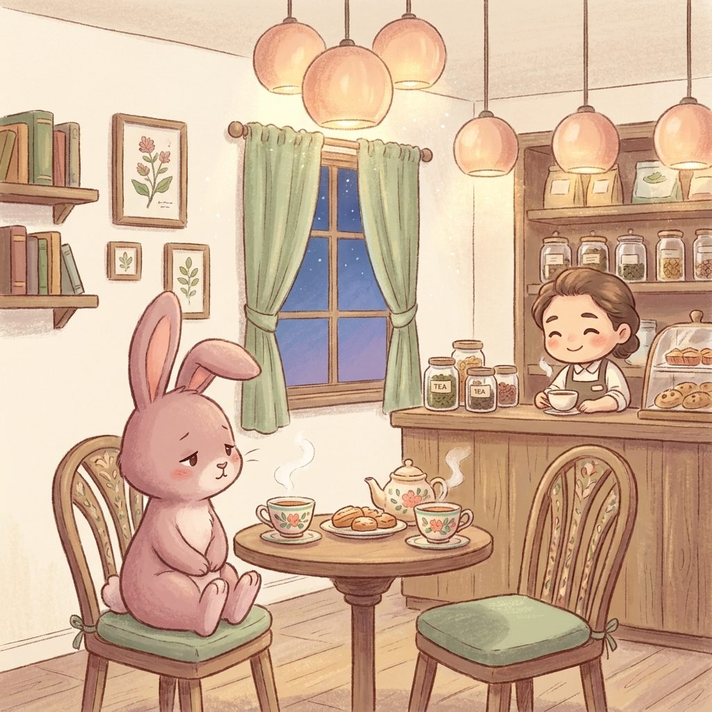

AUDIENCE · ADULTS
Adult tools — quiet utility
Who
What they love
What they buy
Adults who want a personal voice notebook, or a co-parenting conversation aid, without an enterprise price tag.
Local-first (audio in IndexedDB). Token-gated. Model picker exposed (Haiku → Sonnet → Opus).
Personal license or one-off unlock. Scribe is a token-share model to friends today.
APPS IN THIS FAMILY
Scribe
Psy·Co·Parenting
The Hollow
Garden of Words

Slide 14
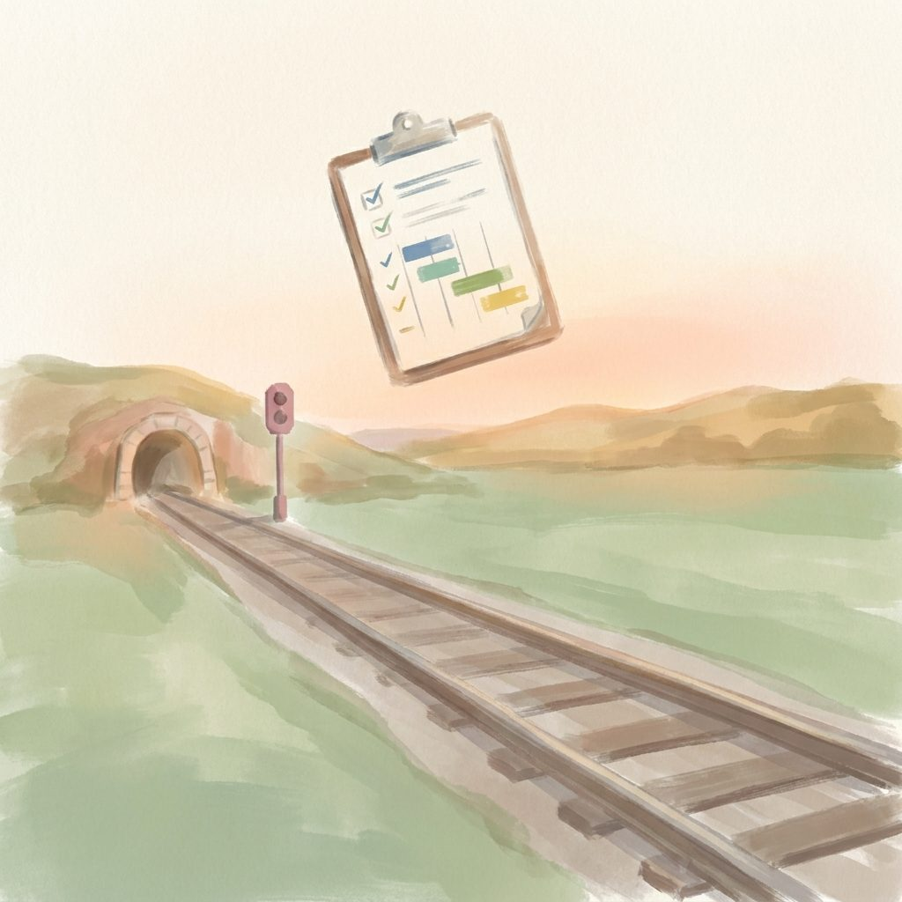
AUDIENCE · COMMERCIAL
Commercial — quietly earning
Who
What they love
What they buy
Station-maintenance vendors and TOCs (Train Operating Companies) needing engineering-access planning tools.
Modelled on Network Rail national constructs (S4/S5/S7 · NR weeks) so any TOC plugs in.
Contract revenue. Founder-led sales, not deck-slick.
APPS IN THIS FAMILY
railplanning.tools
Scribe (rail-mode)

Slide 15
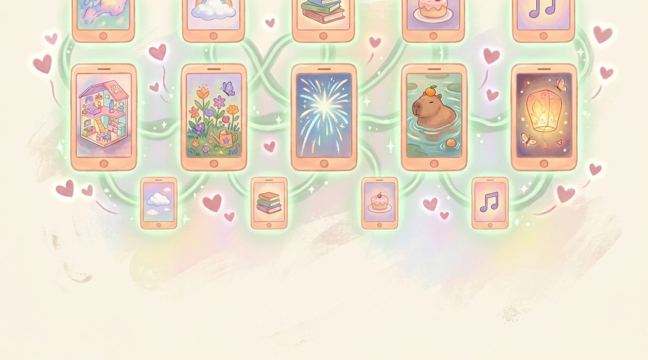
Flagship Showcase
The three apps that carry the brand

Slide 16
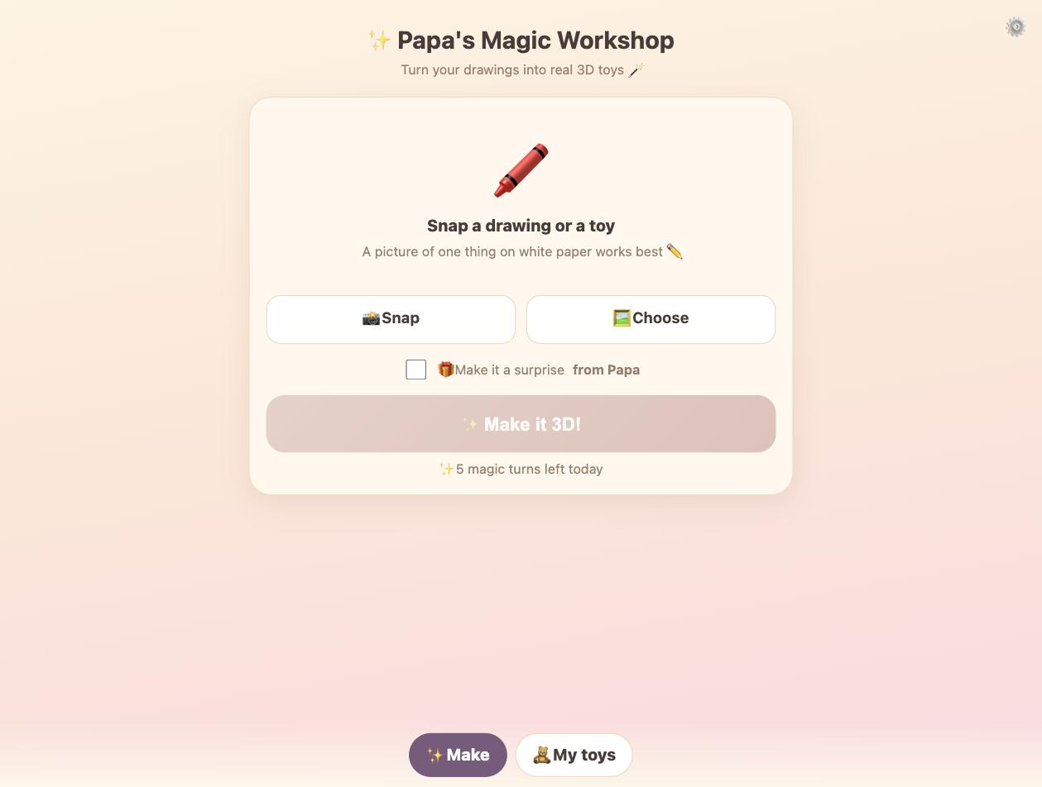
PORTFOLIO · SHOWCASE
Papa's Magic Workshop
A drawing → a spinnable 3D toy → a real printed toy.
All in one warm hand-painted app.
The wow demo. Arianna draws a dinosaur, points a phone at it, and 60 seconds later she has a pastel 3D dinosaur she can spin, keep in a toy box, and 3D print. Or drop into Story House 3D as a playable toy.
Runs the shareable magic loop on TikTok / Reels / Insta Stories in one 15-second clip. It doesn't need explanation — the transformation IS the marketing.
Hybrid safety: instant self-serve with a daily magic-turn cap, PLUS a 'surprise from Papa' toggle that turns any toy into a gift moment.
hero render
LIVE at magic-workshop.pages.dev
LIVE · magic-workshop.pages.dev

Slide 17
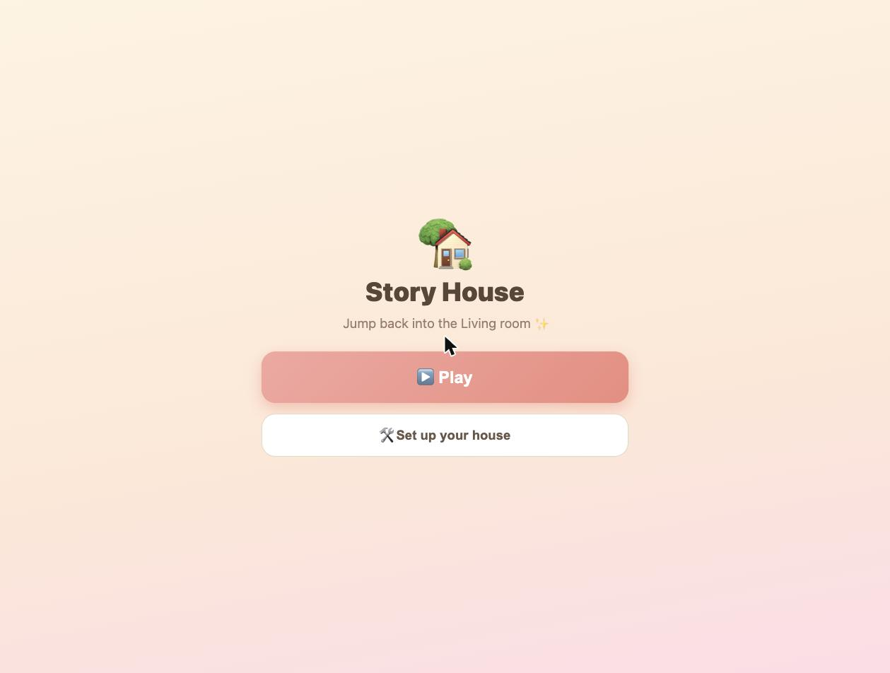
PORTFOLIO · SHOWCASE
Story House 3D
A walkable painterly dollhouse.
Six places, thirty-eight friends, day and night, and warm animated water.
The flagship. Real category (Toca Boca / Sago Mini adjacency) with a differentiated aesthetic and no dark patterns.
Six painterly places: bedroom, kitchen, living room, garden, beach, park. Walkable in 3D, phone-friendly, warm.
Party button emotes all present characters at once — every kid who tries it laughs. The demo sells itself.
hero render
LIVE at story-house-3d.pages.dev
LIVE · story-house-3d.pages.dev

Slide 18
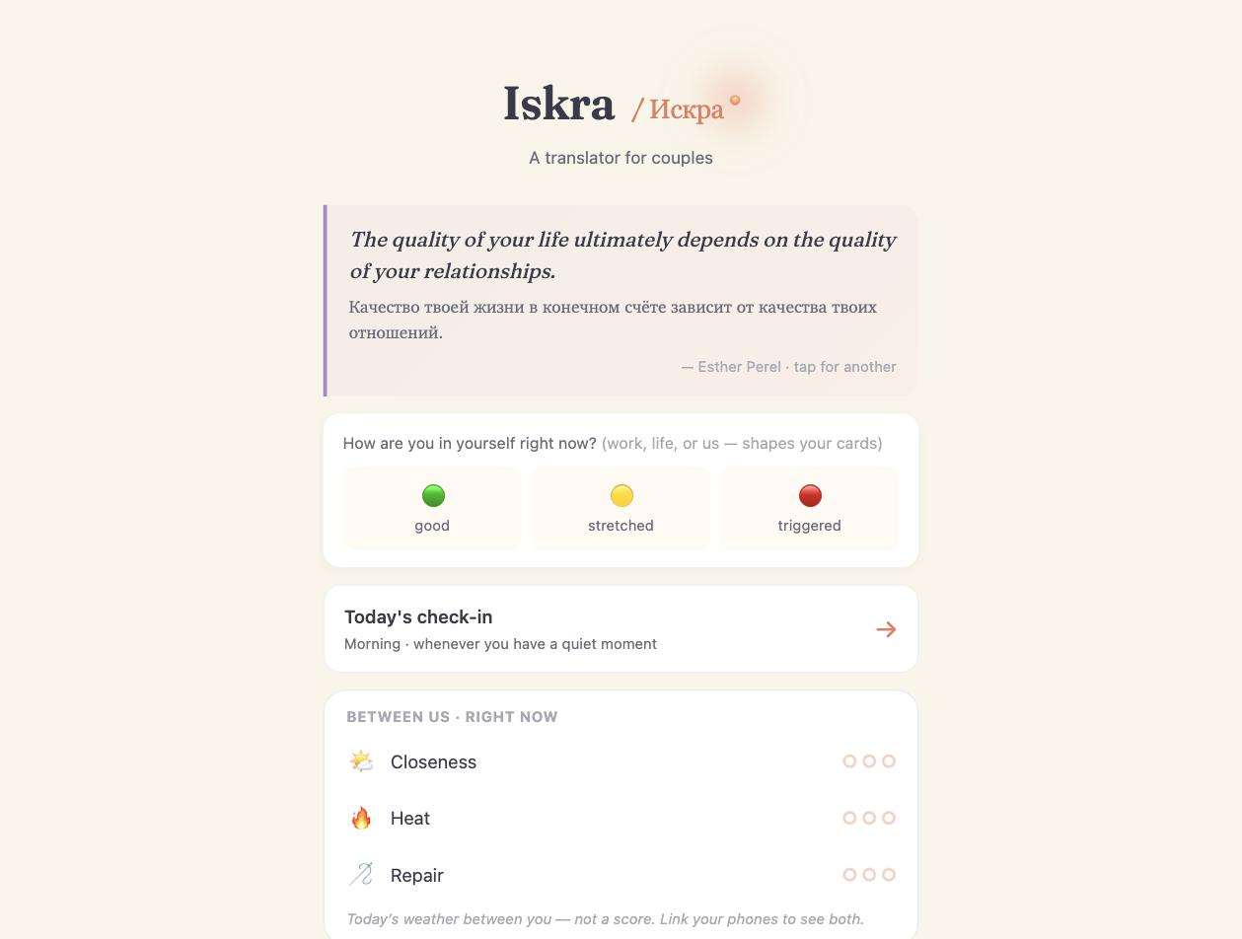
PORTFOLIO · SHOWCASE
Iskra · Искра
A single warm spark rising between two people.
Russian and English, together on one screen.
The bilingual RU/EN couples app that treats Cyrillic-language speakers as first-class.
A translator that softens hard messages using NVC. A Together mode where two phones lock to the same card. A Cycle & Rhythms feature that never lets the AI attribute — deliberately.
Same painterly palette as the kids' apps — the same warm hand made this.
hero render
LIVE at iskra.pages.dev
LIVE · iskra.pages.dev

Slide 19

Campaign Ideas
How the world hears about this

Slide 20
CAMPAIGN · 01
Campaign 1 · The Magic Workshop shareable loop
THE CONTENT
WHY IT WORKS
15-second TikTok / Reels / Shorts:
1. Kid finishes a crayon drawing (2s)
2. Points phone at it (2s)
3. On-screen loading with pastel sparkles (3s)
4. Reveal: spinnable 3D toy version (5s)
5. Cut: same toy printed on a home 3D printer (3s)
No voiceover needed. Music: something warm and hopeful.
This is the format the algorithm rewards: satisfying transformation + child + magic.
Every kid becomes a co-creator. Every parent thinks 'my kid could make one'.
Weekly cadence: seed 3 shorts / week for 8 weeks. Track share ratio + save ratio (not view count).
Expected outcome: at least one video crosses 1M — the algorithm decides which one.

Slide 21
CAMPAIGN · 02
Campaign 2 · The parent-testimonial anchor
THE CONTENT
WHY IT WORKS
A 2-minute launch film: real parents (not actors), showing their kids play Story House 3D for the first time.
No staged wow moments. Just the quiet delight when a kid recognises the papa character on screen matches the papa in the room.
End on: 'No ads. No streaks. No IAP. Built by a papa in Cumbria.'
The parent-ethical positioning is the anti-brand. Making it explicit in the launch anchors every subsequent piece of marketing.
Press angle: 'The dad who built a Toca Boca alternative without dark patterns' — a story that writes itself.
Ends up in parenting newsletters, mumsnet threads, and slow-tech Substacks. Long tail.

Slide 22
CAMPAIGN · 03
Campaign 3 · Iskra's Cyrillic-market launch
THE CONTENT
WHY IT WORKS
A separate track for Iskra:
Bilingual RU/EN social content on TikTok + VKontakte alternatives.
Short-form clips of the Together mode with real couples (subtitled), showing the NVC translator softening a real message.
Partner with Russian-language relationship writers on Substack / TG channels.
The Cyrillic-language market is underserved by every English-only couples app.
NVC framing gives writers a story to tell that isn't about the app — it's about the framework.
Organic seed for a paid Together tier launch in Q3 2026.

Slide 23
DISTRIBUTION
Three lanes, no gatekeepers
Web
All apps are already live on the open web. No app-store gate. Shareable link is the primary CTA.
Cloudflare Pages · Netlify · Cloudflare Workers
iOS TestFlight
Story House 3D + Magic Workshop packaged as a shell. TestFlight lets us seed real parents without an app-store review cycle.
The gentle native path
itch.io + Sketchfab
Stylised 3D asset packs sold to indie developers. B2B revenue that stays inside the pipeline (verify Meshy licence first).
Asset-pack lane

Slide 24
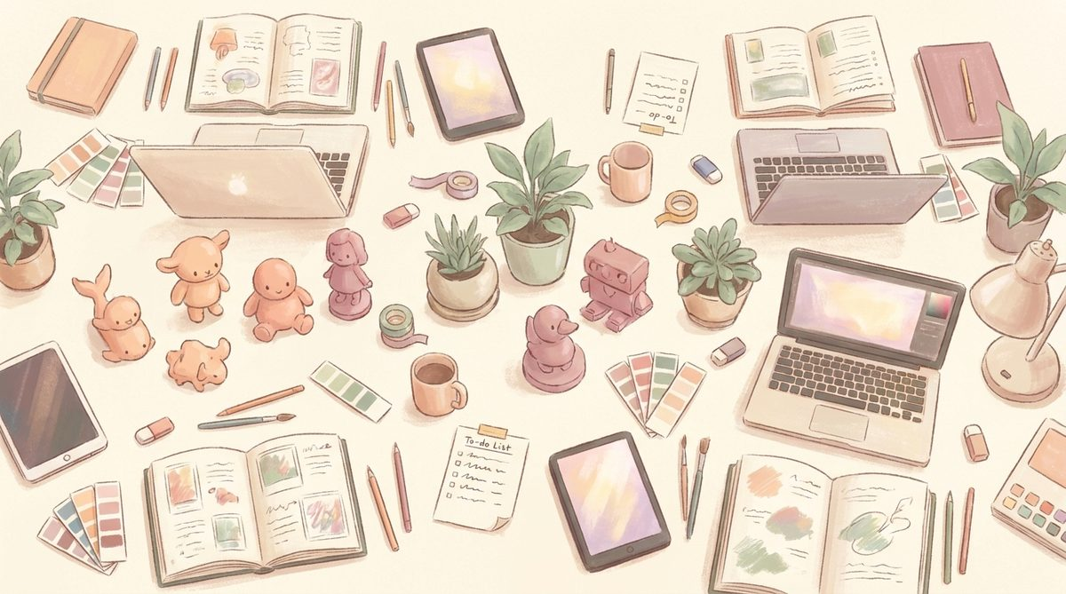
First Eight Weeks
A content calendar sketch

Slide 25
CALENDAR · WEEKS 1-4
Weeks 1–4 · Seed and ship
WEEK 1–2
WEEK 3–4
Week 1: Magic Workshop teaser — 3 short-form videos (crayon → 3D toy). Parent-testimonial casting begins.
Week 2: Story House 3D 'first play' film shot with real families. Seed to slow-tech Substacks.
Week 3: Parent-testimonial launch film goes live. Press outreach to parenting newsletters + Mumsnet.
Week 4: iOS TestFlight open beta announcement. Weekly Magic Workshop shorts continue (twice weekly).

Slide 26
CALENDAR · WEEKS 5-8
Weeks 5–8 · Build the momentum
WEEK 5–6
WEEK 7–8
Week 5: Iskra Cyrillic-market seed content begins. RU-language couples partnership outreach.
Week 6: First parent-paid pack for Story House 3D announced. Pre-order at a soft price for early testers.
Week 7: Asset-pack #1 shipped on itch.io. B2B outreach to indie devs begins.
Week 8: Retro post — 'what eight weeks of building in public looked like'. Prepare next-quarter roadmap.

Slide 27
PRESS · ONE-PAGER
The press one-pager — outline
Headline
"Built by a papa: the pastel studio quietly shipping 20 apps without ads or streaks"
Lede
One person, six months, twenty apps, a shared 3D asset library, and a Meshy pipeline that turns a child's drawing into a spinnable 3D toy.
The angle
Toca Boca / Sago Mini adjacency without the ad-monetised playbook. Warm painterly aesthetic. Parent-first values.
The proof
Live URLs: story-house-3d.pages.dev, magic-workshop.pages.dev, iskra.pages.dev. Real screenshots. Real Arianna quotes (with parental consent).
The pitch
Available for interview. Studio based in the UK. Contact david@eventexperts.online.

Slide 28
BRAND · VOICE
How Nova Code sounds
We are
Warm. Specific. Handmade. Honest about tradeoffs.
We are not
Precious. Corporate. Slick. Streak-driven.
We write
Short sentences. Human details. British spelling where it fits. Named characters (Arianna, Angelina) with consent.
We never write
Manipulative CTAs. Streak-loss threats. "Only X spots left!". Anything that would embarrass Papa if his daughter read it.
On kid-facing surfaces
Only warmth. No urgency, no scarcity, no gamified pressure. Ever.
On adult surfaces
Warmth + honesty. Iskra says the Cycle feature is opt-in and sensitive. Scribe says the model picker exists so users can control cost.

Slide 29
METRICS
What we measure — and what we deliberately don't
WE TRACK
WE DON'T TRACK
Share ratio on shorts (shares / views). Save ratio.
Parents mentioning the app unprompted in reviews or social posts.
Active kids per family per week — with the aim that it stays modest. A kid who plays 10 minutes and leaves is a success, not a failure.
Pack purchases — signal that a parent thought the app was worth thanking us for.
Daily active users. Session length. Streaks. Retention percentages.
These are the wrong metrics for a parent-safe kids' app — measuring them creates pressure to build for them.
We explicitly reject the ad-monetised playbook. The moment we start optimising for time-on-app, we've become the thing we're building against.

Slide 30
GET IN TOUCH
A warm studio, patiently built.
For collabs, press, partnerships, and family testimonials.
david@eventexperts.online · UK-based · Nova Code, 2026.
· BUILT BY A PAPA · NO DARK PATTERNS ·

